Slide 1
Creative Problem Solving:
Generating ideas
Careers Network
Nicola Gittins Deputy Director of Student Entrepreneurship and Enterprise

Slide 2
Defining Creative Problem Solving (CPS)
“CPS is a proven method for approaching a problem or a challenge in an imaginative and innovative way. It helps you redefine the problems and opportunities you face, come up with new, innovative responses and solutions, and then take action” (Creative Education Foundation)

Slide 4
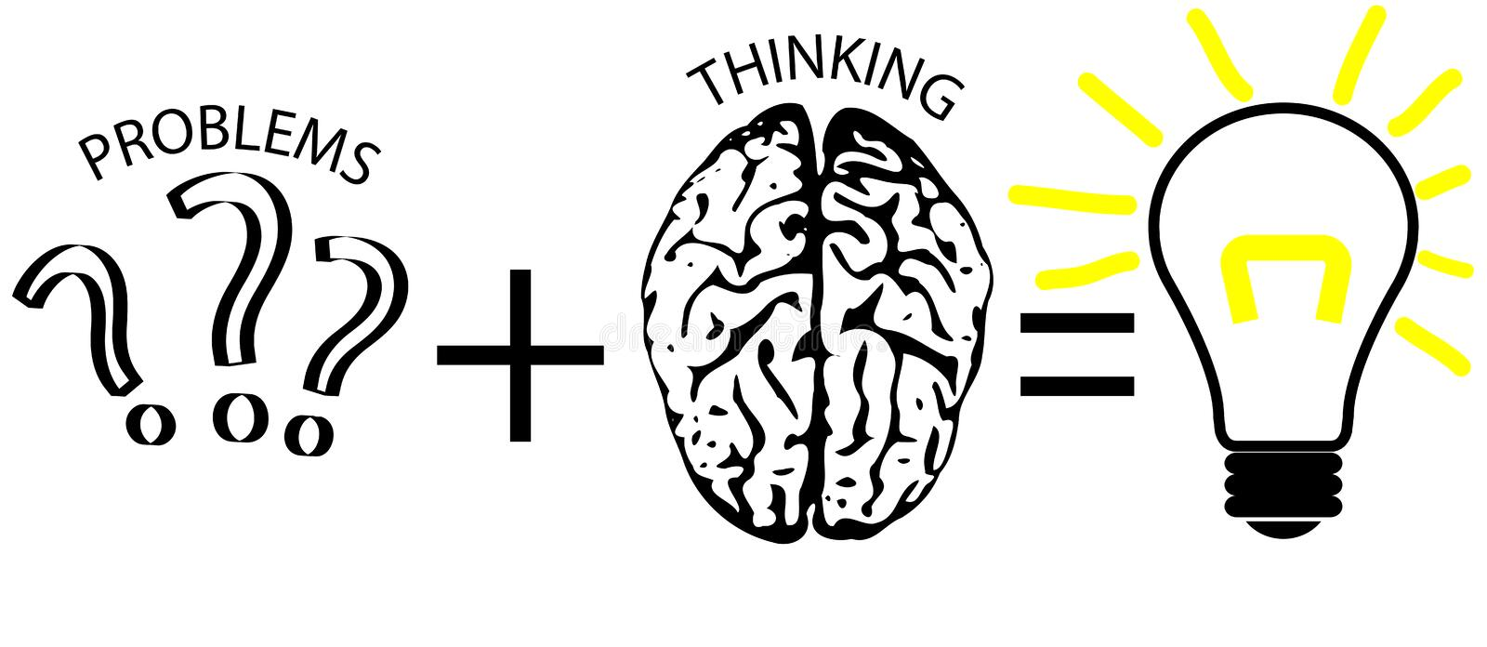

Slide 5
If out of our comfort zone how good are you?

Slide 6
You are part a sinking ship. A fire on board has destroyed the radio and you did not tell the authorities of your destination. You can't jump in to the water is shark infested. The nearest land is an uninhabited tropical island 30 km distant. but you do have life raft however you can only get 5 people in the boat – who do you save?
PASSENGER/CREW LIST
Captain: age 57. Married three times; five children aged between 5 and 27. His youngest child has Down's syndrome. Drinks and smokes heavily. Plays the accordion. Carries a bottle of rum.
Ship's engineer: married; accompanied by his pregnant wife. His heroism in fighting the fire has given his fellow-passengers time to launch the lifeboat but he has sustained severe burns. Carries a shaving mirror.
Radio operator: ex-Israeli Navy. A fitness fanatic and champion kick boxer. He escaped the fire which destroyed his radio as he was on deck trying to impress the food scientist with a display of his kickboxing skills at the time. Carries a length of rope.
Cook: a former Special Forces officer reduced to working as a cook after being court-martialled following an unfortunate incident involving a torpedo and a presidential yacht. Carries a knife.
Anglican priest: a Philosophy graduate who taught English as a foreign language in South America for several years before returning to her home town to look after her disabled mother (now aged 85) with whom she still lives. Trained as a counsellor and was ordained in 1990. Carries a first aid kit.
Diving instructor: After 20 years as a stockbroker in London, he has just moved to Tahiti to set up his own diving school. Divorced, with a son at boarding school in Wales. Goes grouse-shooting in Yorkshire every August. Carries a signed copy of the final Harry Potter novel.
Indian ship's carpenter: Married with four children aged between six months and seven years old. Was convicted of violent affray following a demonstration in Mumbai ten years ago. Writes poetry and has had two poems published in Indian literary magazines. Has a magnifying glass.
Retired soldier. Recently registered a civil partnership with his long-term partner, a 45-year old political journalist. Together, they have campaigned for improved healthcare for soldiers wounded in Iraq.
Carries a compass.
Food scientist. A vegetarian whose research centres on developing plant-based, low-cholesterol alternatives to meat. She has been involved in a number of demonstrations against the use of animals in medical research. Carries a box of Mars bars.
Nurse. Came to Scotland eight years ago as a teenage refugee from Sudan who spoke no English on arrival. Gained 6 GCSEs and has recently qualified as a nurse. Carries a box of matches.
Ship's engineer's wife: Aged 35 and about to begin maternity leave from her work as a medical sales representative. Due to give birth to their first child in 4 months’ time. For some reason known only to herself she happens to be carrying a fishing line and hook.
Bank manager: Lives in a village in Sussex : Guide leader, parish councillor and president of the local allotment society in spare time. Has £50,000 in used £10 notes carried in a small suitcase.
French Botany student: Lived in the Brazilian rainforest for eighteen months while carrying out Ph.D. research into plants that can be used in anti-cancer drugs: these are now undergoing testing by a major multinational pharmaceutical company. Has a rifle.

Slide 7
As in real life there is no single correct answer, any solution could be persuasively argued for example the banknotes carried by the bank manager might not have any monetary value on the island but could be useful for lighting fires or as toilet paper.
A suggested solutions below is based on the principle that the highest probability of survival is rescuing rather than how to live on the island.
Ship’s engineer – mirror vital for signaling
French Botany student – Rifle – signaling
Retired solider – compass get to the island
Food scientist – box of mars bars - reserve food supply
Nurse matches start fire

Slide 8
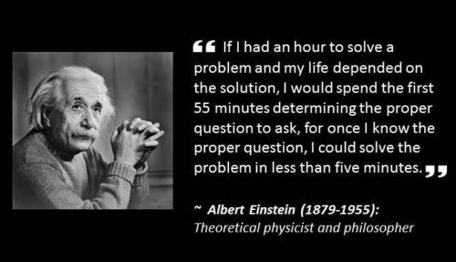

Slide 9
In many underground stations there are two up escalators but only one going down, why?

Slide 10
In front of you there is a lion and just behind you a jaguar. You are armed with an anesthetic gun with only one dart. What are you going to do to survive?

Slide 11
Do you think differently now?

Slide 12
Where do good ideas come from?

Slide 15
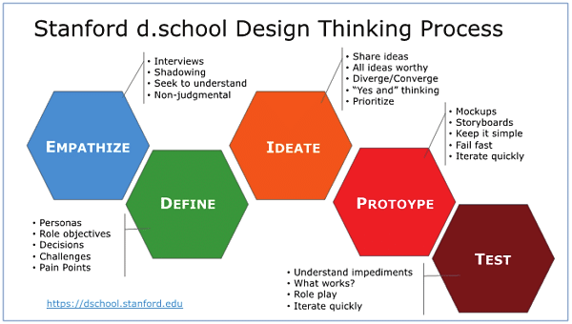
Design Thinking

Slide 17
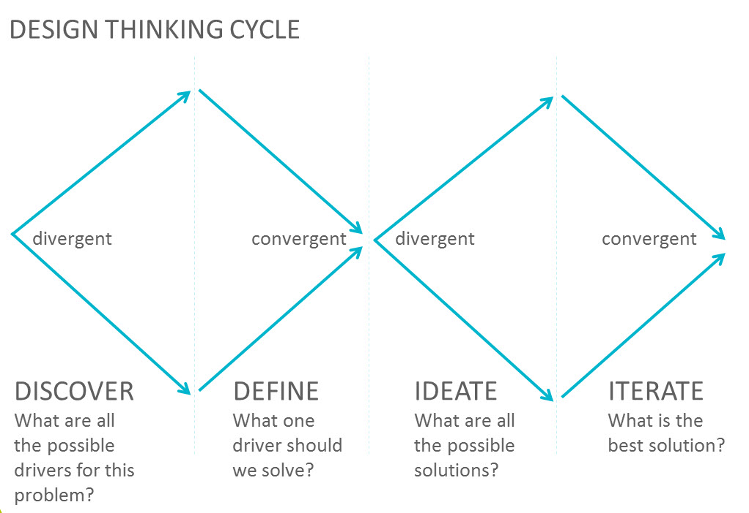

Slide 18
Considerations
Balance
Creative problem-solving uses two primary tools to find solutions: divergence and convergence. Divergence generates ideas in response to a problem, while convergence narrows them down to a shortlist. It balances these two practices and turns ideas into concrete solutions.
Reframe
By framing problems as questions, you shift from focusing on obstacles to solutions. This provides the freedom to brainstorm potential ideas.
Defer
Defer Judgment of Ideas. When brainstorming, it can be natural to reject or accept ideas right away. Yet, immediate judgments interfere with the idea generation process. Even ideas that seem implausible can turn into outstanding innovations upon further exploration and development.
Focus on
Focus on "Yes, And" Instead of "No, But. Using negative words like "no" discourages creative thinking. Instead, use positive language to build and maintain an environment that fosters the development of creative and innovative ideas.

Slide 20
Empathy
Clarify
Define

Slide 21
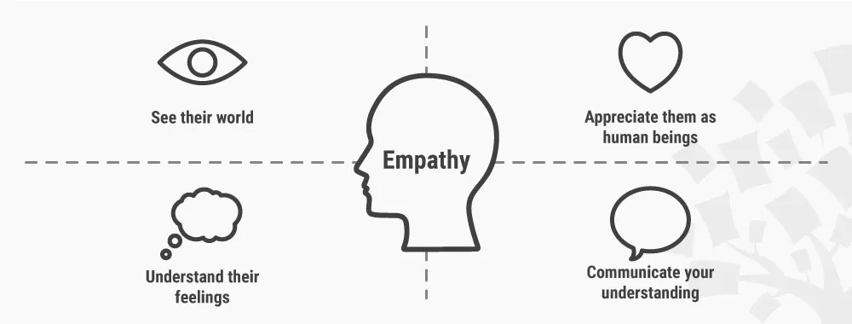
Empathy
Notes:
This is all about the analysis but not simply analysis it is about insights
Here, they should gain an empathetic understanding of the problem to gain real insight into students and their needs.

Slide 24
Notes:
End of problem definition would be a good time for us to check in

Slide 25
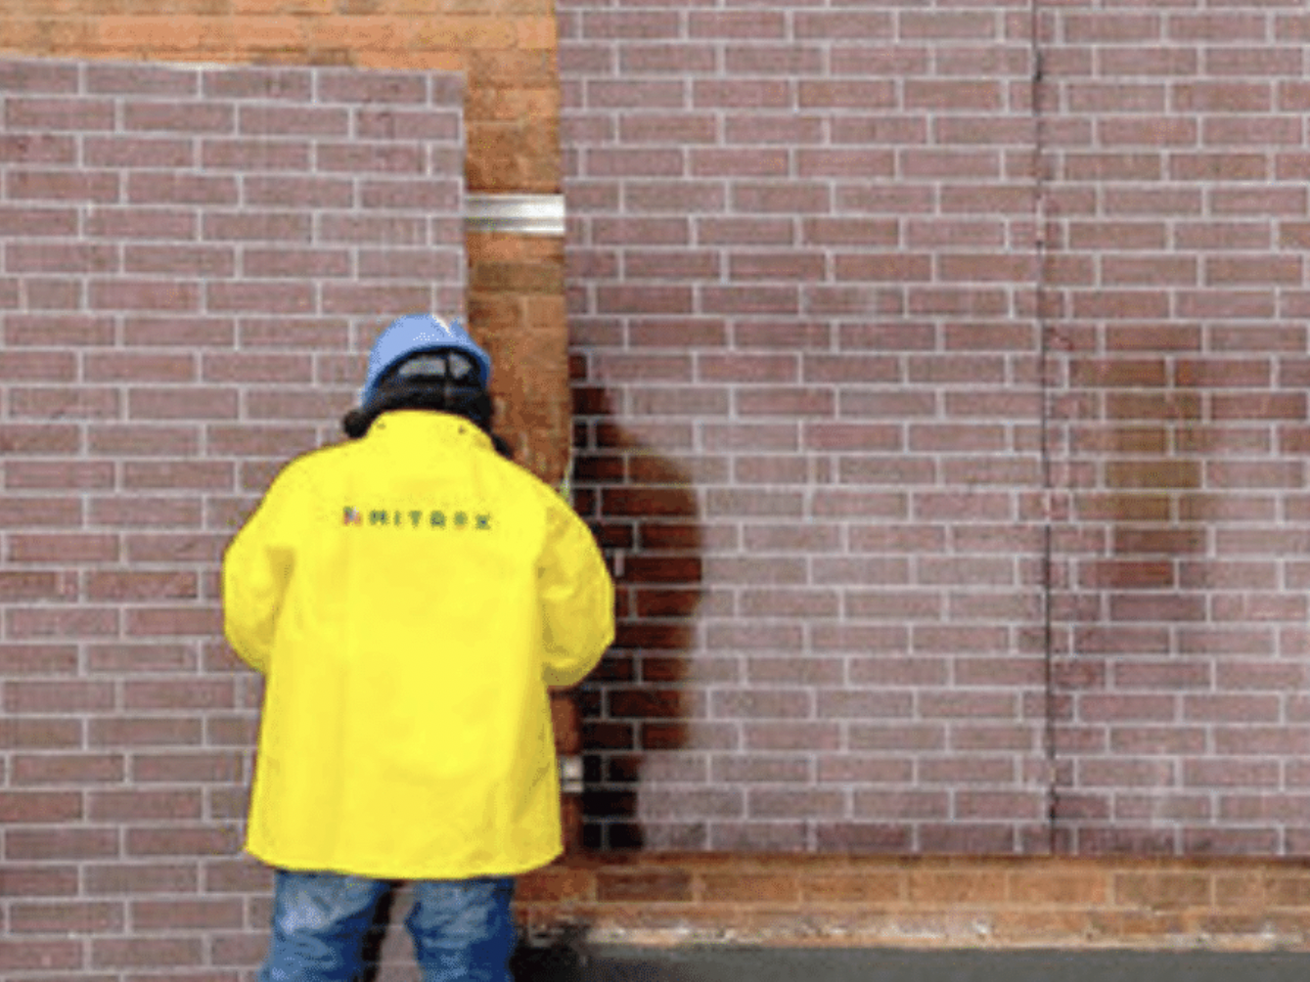

Slide 29
Reframe the question
You are the owner of an office building, and your tenants are complaining about the lifts. They are old and slow, so your tenants often are waiting and now several are threatening to break their leases if you don’t fix the problem.

Slide 30
Two different questions –two different solutions – one is certainly quicker and easier to achieve!
How do we improve the speed of the lifts?
Upgrade the motor system
Implement an algorithm that can predict in advance which floors more likely to be using the lift and whn
How do we make the wait less annoying, so they don’t notice it?
Install music in hallways
Install screens displaying TikTok
Install a water fountain or….?!

Slide 31
Empathy is everything but here are some questions that can help?
What are three other ways to approach this challenge?
What opportunities haven’t we recognised or taken advantage of yet?”
How would they solve this challenge fifty years in the future?
What are some of the worst ideas we can think of? - How can we reverse them to find the seeds of a good idea?
How can we take this wild idea and make it more practical?
What would an insanely great idea or solution look like?
If we knew we couldn’t fail, what would we try?
What else is similar to/different from this?
What is the most audacious thing we can do, say, or imagine?
What haven’t we considered yet?
What’s the single most important thing to focus on here?
What are some radically new or different ways to approach this challenge?
What idea(s) can we push even further?
What possibilities have we missed or not considered yet?
What if we…?
How would a five-year-old solve this challenge?
Note no why questions. ‘Why’ can be dangerous in problem solving if not used in the right way.
Why’ elicits a story/explanations of why something is true. If you ask why nothing is working the way you want it to, you may create a set of bias inferences. However, if reframed and asked the right way can be useful.
c

Slide 33
Brainstorming – Build good ideas from each other’s wild ideas.
Braindumping – Like brainstorming but done individually.
Brainwriting – everyone writes down and passes ideas for others to add to before discussing these.
Brainwalking – Like brainwriting, walk about a room, adding to others’ ideas.
Worst Possible Idea – produce bad ideas can yield valuable threads.
Challenging Assumptions – Overturn established beliefs about problems, revealing fresh perspectives.
Mindmapping – Graphical technique to connect ideas to problems’ major and minor qualities.
Sketching/Sketchstorming – Visuals to express ideas/potential solutions and explore the design space.
Storyboarding – illustrate a situation’s dynamics.
SCAMPER – (Substitute/Combine/Adapt/Modify/Put to another use/Eliminate/Reverse) to produce solutions.
Bodystorming – Role-playing in scenarios/customer-journey steps to find solutions.
Analogies – Draw comparisons to communicate ideas better.
Provocation – Extreme lateral-thinking technique to challenge established beliefs and explore paths beyond.
Movement – Take a “what if?” approach to overcoming obstacles in ideation and finding themes/trends/attributes towards reliable solutions.
Cheatstorm – Previously ideated material as stimuli.
Crowdstorming – Target audiences generate and validate ideas through feedback (e.g., social media) to provide valuable solution insights.
Creative Pause – Take time to pull back from obstacles.

Slide 36
How might we help students stay fit and healthy when they can’t get to a gym.

Slide 37
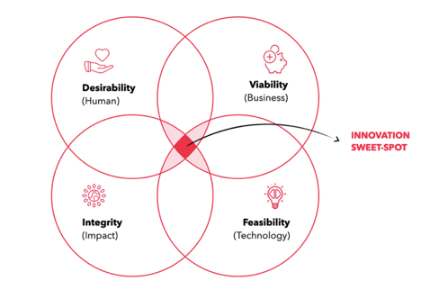

Slide 38
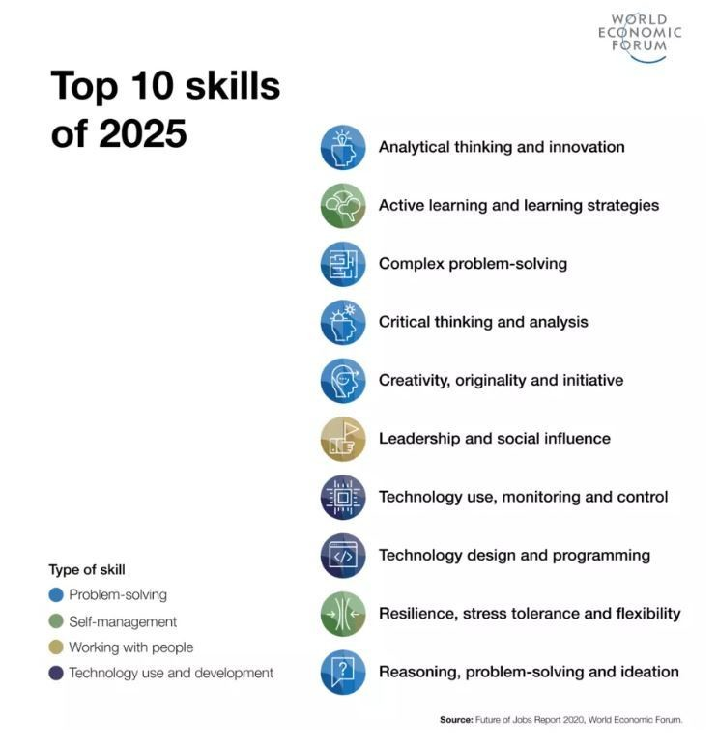
Why important?

Slide 40
Further learning
A crash course in creativity: Tina Seelig at TEDxStanford
Seven Habits of Highly Creative People | Dr. Pavan Soni | TEDxIBSPune
LinkedIn Learning: Critical Thinking and Problem Solving
Hidden Path to Creativity

Slide 41
Your PG team and further support

Slide 42
CAREERS NETWORK IS HERE FOR YOU
PG Skills Canvas course: https://canvas.bham.ac.uk/enroll/PKYPEA
PG Careers Events: https://intranet.birmingham.ac.uk/as/employability/careers/events/postgraduate-events.aspx
1:1 guidance support:
You don’t need to have career ideas or a plan to come and talk to us: we help people who have no idea where to start as well!
To book an appointment, ask a question, have an application checked etc., please email careersenquiries@contacts.bham.ac.uk
PGT-specific opportunities:
Professional Development Award: https://canvas.bham.ac.uk/enroll/4AMG6T
PG Skills sessions contribute towards hours required Professional Development activities, PPDA
PGR-specific opportunities:
Career Mentor Beyond Academia https://canvas.bham.ac.uk/enroll/M7WCDE

Slide 43
Upcoming programmes
Opportunities to work on real life challenges, set by an employer:
MCTI – open to CAL, IDD and Engineering (Civil, Chemical and Mechanical) PGT students
MCC – Two week programme (June 2023) for PGT students
https://intranet.birmingham.ac.uk/as/employability/careers/postgraduate/pgt/mcc.aspx
PESS –Week long programme for PGR students
https://intranet.birmingham.ac.uk/as/employability/careers/postgraduate/pgr/pess.aspx

Slide 44
Let's get this start-up started
Inspiring stories
B-Enterprising pages

