Slide 1
PG Skills - From Academia to Industry: How to sharpen your pitch skills

Slide 2
CAREERS NETWORK IS HERE FOR YOU
PG Careers Events: https://intranet.birmingham.ac.uk/as/employability/careers/events/postgraduate-events.aspx
PG Skills Canvas course: https://canvas.bham.ac.uk/enroll/PKYPEA
1:1 guidance support:
You don’t need to have career ideas or a plan to come and talk to us: we help people who have no idea where to start as well!
To book an appointment, ask a question, have an application checked etc., please email careersenquiries@contacts.bham.ac.uk
PGT-specific opportunities:
Professional Development Award: https://canvas.bham.ac.uk/enroll/4AMG6T
PG Skills sessions contribute towards hours required Professional Development activities, PPDA
PGR-specific opportunities:
Career Mentor Beyond Academia https://canvas.bham.ac.uk/enroll/M7WCDE

Slide 3
Upcoming programmes
Opportunities to work on real life challenges, set by an employer:
MCTI – open to CAL and Engineering (Civil, Chemical and Mechanical) PGT students
https://www.intranet.birmingham.ac.uk/as/employability/careers/postgraduate/pgt/mcti-form.aspx
MCC – Two week programme (June 2023) for PGT students
https://intranet.birmingham.ac.uk/as/employability/careers/postgraduate/pgt/mcc.aspx
PESS –Week long programme for PGR students
https://intranet.birmingham.ac.uk/as/employability/careers/postgraduate/pgr/pess.aspx

Slide 4
From academia to industry:
How to sharpen your pitch skills

Slide 6
Debunking The Myths
I ' L L D OWN L OAD A P R E VIOU SL Y SU CCE SSF U L T E MP L AT E AN D AD AP T IT
No such thing as a universally great pitch deck

Slide 7
Debunking The Myths
A P IT CH D E CK T O IN VE ST OR S H AS T O B E 1 0 SL ID E S
10 Works.
More Works.
Less Works Too.

Slide 8
Debunking The Myths
T H E GOAL OF A P IT CH D E CK IS T O GE T IN VE ST ME N T
The goal is to get them INTERESTED

Slide 11
Developing A Winning Pitch Deck

Slide 12
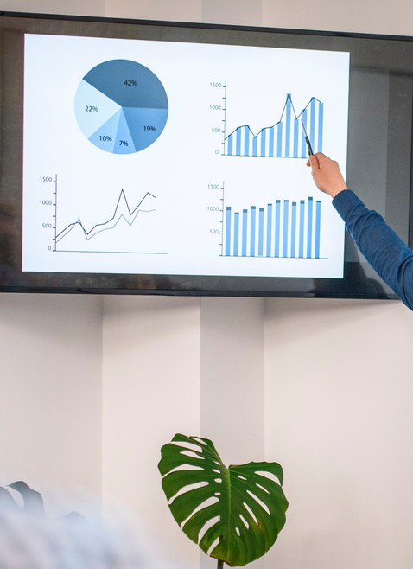
Factors To Consider
I N O R D E R O F I M P O R T A N C E . . .
Audience
Business
Story
Channel
Design

Slide 14
Tips To Note
YOU are the pitch, not the slides.

Slide 15
Tips To Note
Being RELATABLE is more important than sounding intelligent

Slide 16
Tips To Note
Success lies in the quality of your ASSUMPTIONS

Slide 17
Pitch Deck Best Practices

Slide 18
Best Practices
HOW MUCH TI ME TO SPEND ON EACH SLI DE I N A 3 MI NUTE PI TCH
Problem
- 11secs
Solution
- 10 Secs
Why Now
- 16 Secs
Market Size
- 13 Secs
Product
- 11 Secs
Team
- 22 Secs
Business Model
- 15 Secs
Competition
- 17 Secs
Financials
- 23 Secs

Slide 19
Practical Notes
If you have no traction, your idea has to be a HIGHLY INNOVATIVE one

Slide 20
Practical Notes
Break the cash into TRANCHES and MILESTONES

Slide 21
Practical Notes
Demonstrate the influence of the funds on your PROJECTIONS

Slide 22
Things to Avoid
Things to avoid when pitching
Too much data
Avoiding eye contact
Going over time
Defensiveness
No Story

Slide 23
Summing Up
A winning pitch deck is one that is tailored specifically to the context in which it is to be used...

