Slide 1
PG Skills: How emotional intelligence shapes who we are, how we relate to others and our relationships
Lynsey Kitching, Co-Founder & Director
Cape Coaching & Development Ltd

Slide 2
HOUSEKEEPING
Attendance
Phones on silent
PG Skills Canvas course
PG Skills Canvas Course: https://canvas.bham.ac.uk/enroll/PKYPEA

Slide 3
CAREERS NETWORK IS HERE FOR YOU
1:1 guidance support:
You don’t need to have career ideas or a plan to come and talk to us: we help people who have no idea where to start as well!
To book an appointment, ask a question, have an application checked etc., please email careersenquiries@contacts.bham.ac.uk
PGT-specific opportunities:
Professional Development Award https://canvas.bham.ac.uk/enroll/4AMG6T
PGR-specific opportunities:
Career Mentor Beyond Academia https://canvas.bham.ac.uk/enroll/M7WCDE

Slide 4
Upcoming Opportunities
PG Skills - How Project Management skills are used in industry (21 March 2023)
https://bham.targetconnect.net/leap/event.html?id=16351&service=Careers+Service
Masters Campus-based Team Internship – Engineering PGT students
https://intranet.birmingham.ac.uk/as/employability/careers/postgraduate/pgt/mcti-form.aspx
Masters Consultancy Challenge (12 – 23 June 2023) – All PGT students
https://intranet.birmingham.ac.uk/as/employability/careers/postgraduate/pgt/mcc.aspx

Slide 5
ANY QUESTIONS?
Contact us via careersenquiries@contacts.bham.ac.uk
www.intranet.birmingham.ac.uk/careers/pg

Slide 6
Emotional Skills
PG Skills Session

Slide 7
Overview of this workshop
We will equip you with some of the theory around what emotional intelligence is and why it is important in our careers, education, and lives in general.
We will explore practical ways to develop emotional intelligence and explore what stands in our way.
Together we will enable you to develop effective relationships and identify your own key area of emotional intelligence that can be improved and provide you with some empowering strategies that can be put into action.

Slide 8
Emotional intelligence

Slide 9
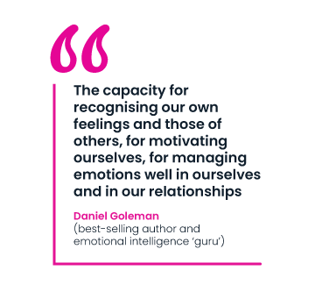
The foundations of emotional intelligence: what it is and why it is important for us
Most people don’t recognise the effect that their own and others’ emotions have on behaviour
The more your work depends on personal relationships (i.e. as member of a team, project leader or direct supervisor of others), the more critical it is to effective performance
Developing self-awareness is the first step to developing emotional intelligence
Notes:
Examples of how on Master's course this is relevant

Slide 10
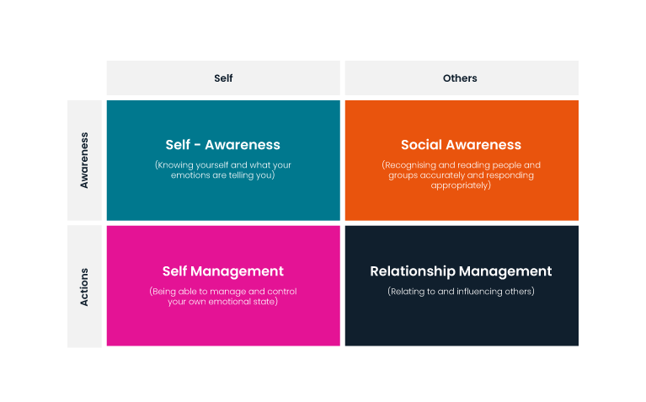
The four dimensions of emotional intelligence
By doing this you can create a positive impact on others
Notes:
Use Education examples

Slide 11
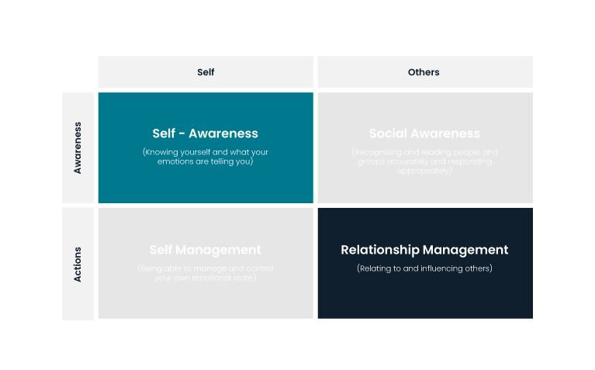
The heart of emotional intelligence and why this is so important for us…
Awareness of your emotions
Insight into their impact on your performance
Honesty in your positive and negative biases
If people lack Self-Awareness, their chances of having Self-Management and Social Awareness are significantly reduced
Notes:
Awareness of your emotions
Insight into their impact on your performance
Honesty in your positive and negative biases
ECI (Emotional Competence Inventory) research has found that if people lack Self-Awareness, their chances of having Self-Management and Social Awareness are much reduced

Slide 12
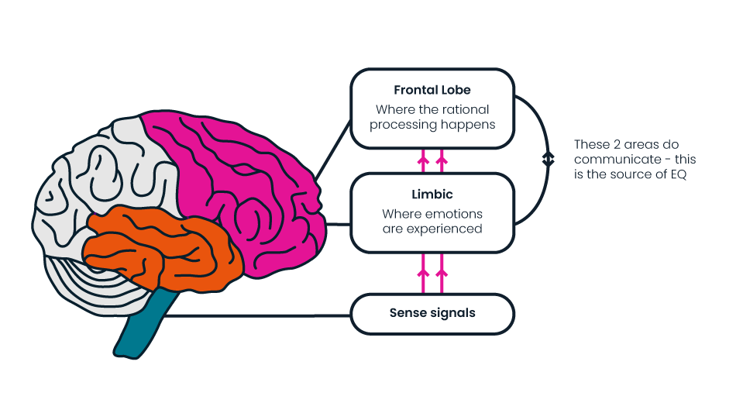
The brain and emotional intelligence

Slide 13
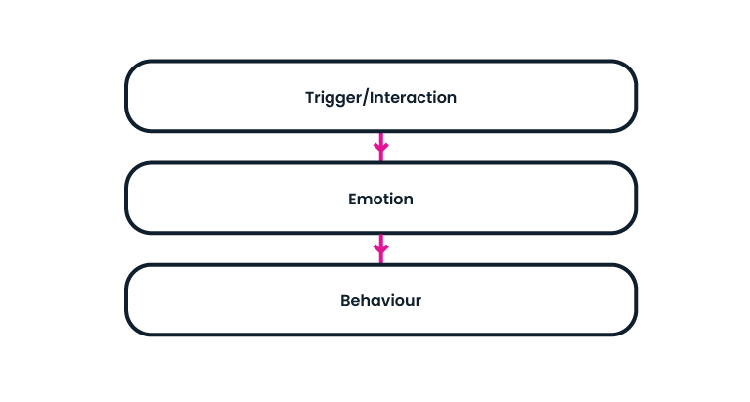
What happens in practice
Notes:
Thought cycle

Slide 14
Self awareness around emotions
Notes:
Awareness of your emotions
Insight into their impact on your performance
Honesty in your positive and negative biases
ECI (Emotional Competence Inventory) research has found that if people lack Self-Awareness, their chances of having Self-Management and Social Awareness are much reduced

Slide 15
Developing our self-awareness and expanding our emotional vocabulary
Have a think about two recent experiences:
One which generated positive emotions
One which generated more difficult emotions
For each label the emotions that you felt
Notes:
Do this bit on their own before showing the feeling wheel

Slide 17
Developing our self-awareness and expanding our emotional vocabulary
Have a think about two recent experiences:
One which generated positive emotions
One which generated more difficult emotions
For each label the emotions that you felt
In pairs use the feeling wheel to review the emotions that were present – now you have an expanded vocabulary do the labels you use change?
What insight does this give you about what was going on for you?
What can we learn from this exercise?

Slide 18
Emotional awareness and agility
“When we label our emotions accurately, we are more able to discern the precise cause of our feelings.”
Diversity isn’t just people, it’s also what’s inside people, including diversity of emotion.”
Susan David (Psychologist, Harvard Medical School, Author of Emotional Agility)
This Photo by Unknown Author is licensed under CC BY-NC-ND

Slide 19
Emotional Agility
Emotions are pre-cursors to action – we wouldn’t do anything if we didn’t feel an emotion.
Having a greater awareness of the emotion we feel gives us more awareness in what is going on and more choice in how we respond.

Slide 20
Relationship management
Notes:
Awareness of your emotions
Insight into their impact on your performance
Honesty in your positive and negative biases
ECI (Emotional Competence Inventory) research has found that if people lack Self-Awareness, their chances of having Self-Management and Social Awareness are much reduced

Slide 21
Thinking about our ‘shadow selves’

Slide 22
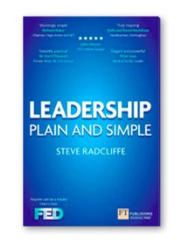
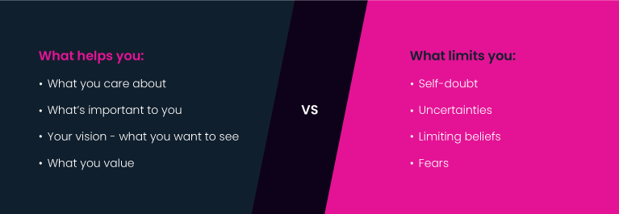
Putting it together – our ‘shadow selves’
Understanding how you communicate especially when you are under pressure is key to creating trust and the impact you intend​.
When you understand your emotional responses, you are more likely to be able to manage your ‘shadow self’​.
What can affect the impact you have or brings out your ‘shadow self’?​
Adapted from Leadership Plain and Simple, by Steve Radcliffe

Slide 23
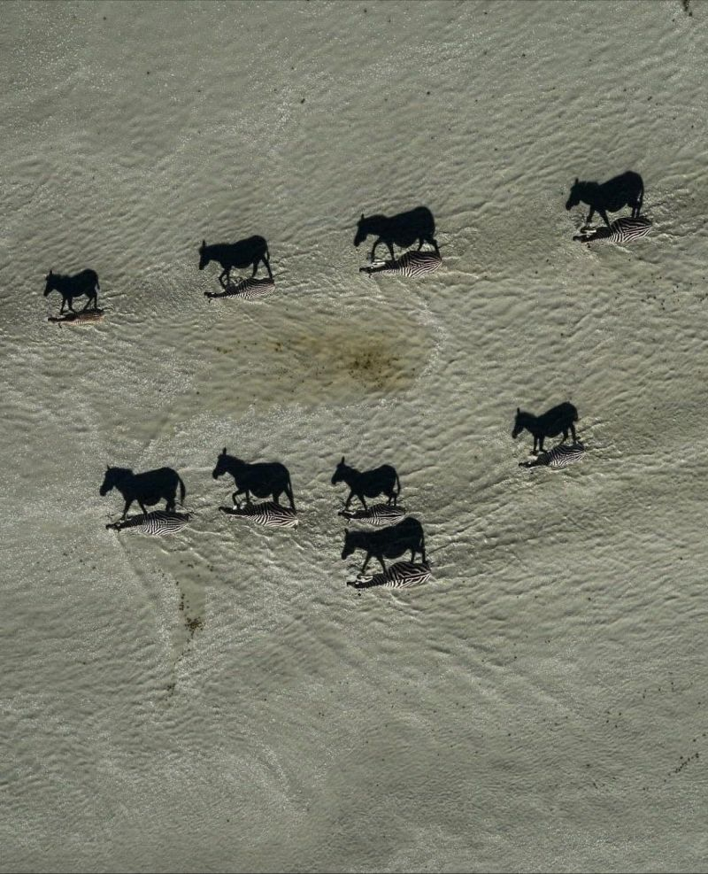
Your shadow can loom larger than you think…
Photo by Beverly Joubert: National Geographic photograph of the year
Notes:
This is the National Geographic Picture of The Year. The black images are shadows of zebras. Zoom in and you will see the actual zebras. If you are someone in a position of #power, please recognize that your shadow looms larger than you think. As a #leader, everything you say (and don’t say) and do (and don’t do) is magnified — maybe even disproportionately. You cast a large shadow and take up more space in others’ minds than you think. To you, you’re the zebra. To others, you’re the shadow. Doing the work to develop #selfawareness can help you better understand and mitigate the unintended impact you may have on others just by being in a position of power. Photo by Beverly Joubert

Slide 24
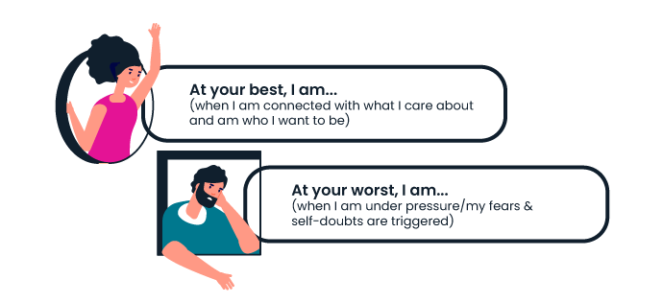
Shadow selves…
Think about what it’s like when you are…

Slide 25
Shadow cast exercise…
 | At my best… | At my worst…
What others might see?

Slide 26
Shadow cast exercise…
 | At my best… | At my worst…
What others might see? | Engaged, present, really listening, focused, positive, lots of energy, goal focused but curious | Distracted, irritated, defensive, ‘snappy’, withdrawn

Slide 27
Exercise
Individually:
Think about and capture how you show up for both ‘at my best’ and ‘not at my best’.

Slide 28
Shadow cast exercise…
 | At my best… | At my worst…
What others might see?
What might be the impact on them?
How might this impact the team environment?

Slide 29
Shadow cast exercise…
Me: | At my best… | At my worst…
What others might see? | Engaged, present, really listening, focused, positive, lots of energy, goal focused but curious | Distracted, irritated, defensive, ‘snappy’, withdrawn
What might be the impact on them? | Gain energy from me, feel upbeat, feel driven, feel valued | Uncertain of how to approach me, doubting themselves, frustrated, demotivated
How might this impact the team environment? | Energy, positivity, excitement, fun, high support and high challenge | Reduced collaboration, reduced support, reduced productivity, people feeling a lack of support / feeling undervalued
Notes:
Let’s look at this for me…

Slide 30
Exercise
In pairs/trios:
Share what you have captured for both ‘at my best’ and ‘not at my best’.
Discuss and capture:
What might the impact on others be?
How might this impact on the team environment?
What specific actions are you going to take?

Slide 31
In essence…
“no matter what I think I know about myself there is always more to discover”
Notes:
In essence what we really need to think / believe to truly become self aware
Get feedback, be curious – get

Slide 32
Your reflections…
Notes:
Key learnings and reflections?
Specific actions you might need to take?

Slide 33
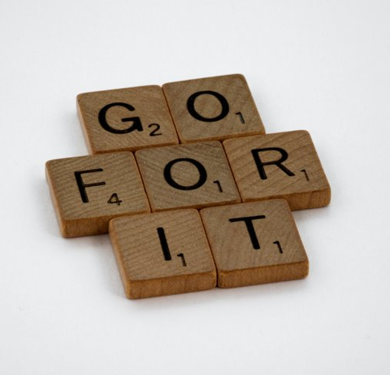
Check out
What are your key takeaways?
What one action will you commit to as a result of the conversations today?

Slide 34
Further resources
https://hbr.org/2020/12/what-people-still-get-wrong-about-emotional-intelligence
https://www.forbes.com/sites/forbescoachescouncil/2022/12/30/why-is-emotional-intelligence-important/?sh=5cfb9b8f3289
https://positivepsychology.com/emotional-intelligence-ted-talks/

Slide 35
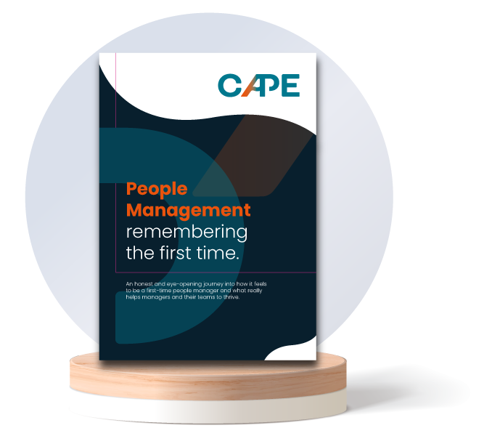
Join the CAPE Community
Our mission is:
To disrupt the way people learn how to manage others.
To empower them to feel confident in their management style, equipping them with a toolkit of resources for every scenario and enabling them to build effective relationships with their teams.
To help as many people as possible to have positive experiences of people management, both the managers themselves and the individuals they manage. In essence to create a butterfly effect.
To provide a community for first time or new people managers to learn, share, grow and ultimately develop the self-belief needed in their roles and beyond. A community that you can draw on to work through challenges long after the programme has finished.
To spread the word - for that community to share their learning with the next generation of people managers by providing coaching / mentoring as part of a social impact project.
To download the full copy of the report and find out more visit www.wearyourcape.co.uk
Notes:
This is what we do at CAPE...

Slide 36
Naomi: naomi@wearyourcape.co.uk
Lynsey: lynsey@wearyourcape.co.uk

