Slide 1
PG Skills: How Project Management skills are used in industry
Dr Alyson Nicholds
Director, Leadership Learning Ltd©

Slide 2
HOUSEKEEPING
Attendance
Webcams
Audio
You can use the public chat box to ask any questions
PG Skills Canvas course
PG Skills Canvas Course: https://canvas.bham.ac.uk/enroll/PKYPEA

Slide 3
CAREERS NETWORK IS HERE FOR YOU
1:1 guidance support:
You don’t need to have career ideas or a plan to come and talk to us: we help people who have no idea where to start as well!
To book an appointment, ask a question, have an application checked etc., please email careersenquiries@contacts.bham.ac.uk
PGT-specific opportunities:
Professional Development Award https://canvas.bham.ac.uk/enroll/4AMG6T
PGR-specific opportunities:
Career Mentor Beyond Academia https://canvas.bham.ac.uk/enroll/M7WCDE

Slide 4
Upcoming Opportunities
PG Skills: What does it mean to have an entrepreneurial mindset? How can you apply the entrepreneurial mindset in a variety of settings? (18 April 2023, 13:00 – 14:30) https://bham.targetconnect.net/leap/event.html?id=16749&service=Careers+Service
Masters Consultancy Challenge (12 – 23 June 2023) – All PGT students
https://intranet.birmingham.ac.uk/as/employability/careers/postgraduate/pgt/mcc.aspx

Slide 5
ANY QUESTIONS?
Contact us via careersenquiries@contacts.bham.ac.uk
www.intranet.birmingham.ac.uk/careers/pg

Slide 6
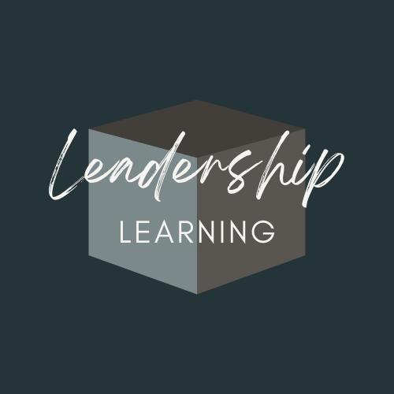
PG Skills: Managing Projects well
™
Dr Alyson Nicholds
Director, Leadership Learning Ltd©
DrNicholds@outlook.com
©Leadership Learning All Rights Reserved
Notes:
INTRO: PM as a core skill in industry that employers value but we don’t always know that we have
PROCESS: So we’re going to spend some time reflecting on what we we know about projects already
INVOLVEMENT: so, if I could ask you to turn your cameras on and put your answers in the chat (we’ll be learning together)

Slide 7
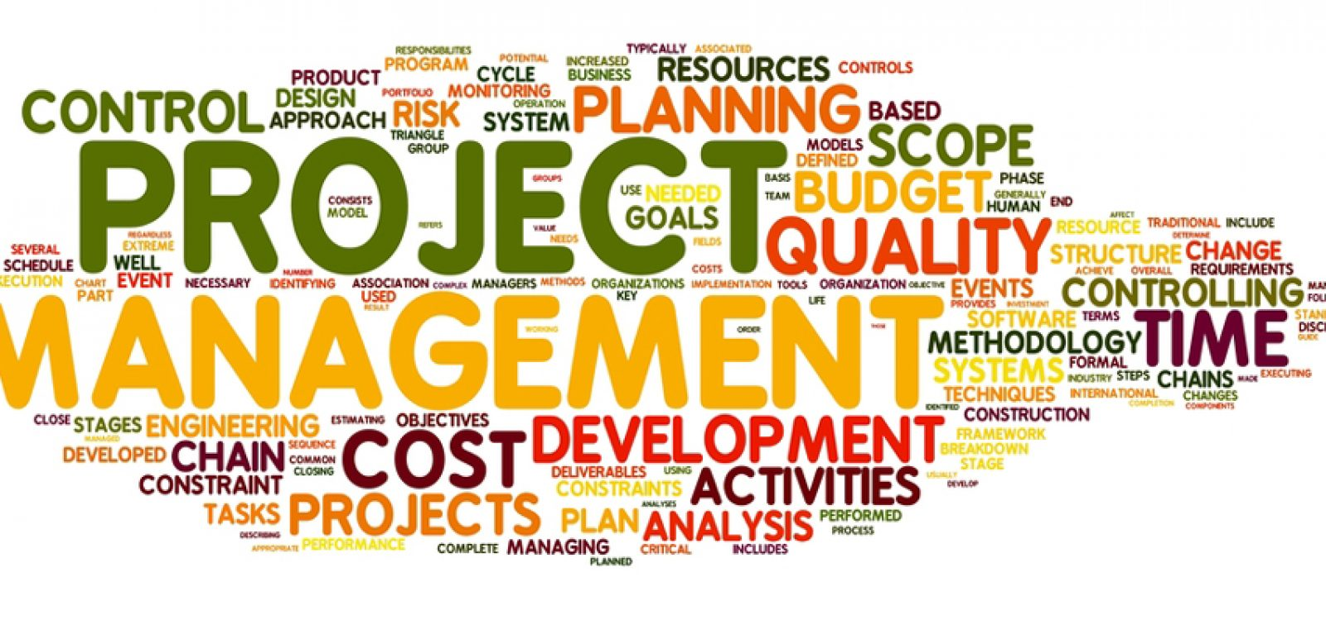
Help, I need project management skills!
Project Management is a technique that’s used in industry to help you achieve your project goals. It requires knowledge of methods, skills and experience to bring the process to life. But how do you acquire this, when you’ve not actually managed any major projects before? This session will help you identify what you already know!
This Photo by Unknown Author is licensed under CC BY-NC-ND
This session aims to build your capability (know-how) by bridging your practice (what you already know) with theory!
PM Skills: Reflect on your experience of projects in your PGT/PGR studies to recognise where projects happen naturally (Experiential Learning)
PM Techniques: Frame Project Management as a concept to formally explore the process (Management Accounting)
PM Identity: Talk about yourself as a real-life project manager with CV/ Job applications in mind (Leadership Theory)
APM | The Chartered Body For The Project Profession
©Leadership Learning All Rights Reserved
Notes:
Project Management is a technique that’s used in industry to help you achieve your project goals.
It requires knowledge of methods, skills and experience to bring the process to life but how do you acquire this, when you’ve not managed any major projects before?
This session aims to build your capability (know-how) by bridging your experience of projects with theory

Slide 8
Projects all around us in industry
WARM-UP
Pick an image that you’re drawn to (i.e. future career?) and consider what major projects are underway and why (i.e. Rail:HS2/ Apparel: recycling fashion/ Shipping: Carbon-neutral/ NHS: Digitisation)
Project X (bettergovprojects.com)
©Leadership Learning All Rights Reserved
Notes:
Your credibility in your future career depends on knowing what projects look like in industry (interviews) & Trustworthiness in talking confidently about your knowledge and experience (what you’ve already done)
So pick an image that you’re drawn to (feel?), say why you’re drawn to it (future career); and a project that’s underway (HS2/ Recycling/ Decarbonisation) and why (Competitiveness/ Climate Change/ Productivity)
Project X: Partnership between Government/ Academia/ Industry to improve project delivery through world class research (i.e. TO ENSURE PUBLICLY FUNDED PROJECTS ARE IMPLEMENTED WELL i.e. Heathrow, Crossrail, Westminster Palace)

Slide 9
Learning from past experience
The strategic importance of projects in our organisations means developing our capability to manage projects so that plans can be actually implemented !
Learning theory tells us that the best way of doing this is to reflect on the experiences that we’ve already had where projects naturally came into being (experiential learning) (Cunha)043-0683.pdf (pomsmeetings.org)
Project Management:-“the use of proven, contemporary project management theory and practice in planning, organizing, leading and controlling resource (Cleland 1985)” A strategy for ongoing project evaluation (pmi.org)
Leadership theory tells us that we need to keep whilst context matters, the process is rarely linear and time is constructed by us! (Barrett & Hatch 2003)
KNOW-HOW
We sometimes forget that not all learning takes place in the classroom! In fact we are constantly learning by comparing what we experience (see, feel, hear); with what we think (what just happened) and we use this to either construct new or adapt existing ideas, constantly learning and unlearning (lifelong learning)”
Experiential Learning | Kolb Experiential Learning | Experiential Learning Theory (experientiallearninginstitute.org)
Concrete (experience of projects?)
Reflective (how we did it?)
Abstract (what tools ?)
Experiment (what you’d change)
David Kolb-Experiential Learning - YouTube
Experiential Learning | Kolb Experiential Learning | Experiential Learning Theory (experientiallearninginstitute.org)
©Leadership Learning All Rights Reserved
Notes:
Strategic importance of projects in industry means learning how to manage them well (85% change projects fail)
Requires us to reflect on our own experience of managing small projects, reflecting on the skills used and how we might draw on these to plan future projects
PM is just about applying our knowledge, skills and experience to the problems that come up naturally, using our leadership (confidence/ trustworthiness)

Slide 10
Bringing ideas to life in a project
KNOW-HOW
“It’s often a problem or issue that comes up naturally at work which needs some boundaries putting around it (i.e. to form a project)! In my own case, I began leading projects as a Public Health Practitioner in the 2000's using PM techniques without realising it (needs analysis, stakeholders). In each case, I had to work out the best way of analysing the problem (what was going wrong), identify who was affected by it (stakeholders) and decide how to resolve it (activities)! Only now, since leading multiple projects as Researcher (PM), that I realise I used agile techniques (post-it’s) (to make sense of issues before mapping activities)” Dr Alyson Nicholds
My role: Community Worker on a deprived estate (PCT)
What needed to change? Improve access to services
How did the need arise? I needed to design interventions
What I did: I decided to conduct local research on need
My role: Researcher on a £300K Research Project (University)
What needed to change: Join-up health & social care
How did the need arise? How were stakeholders doing it?
Role I played: I interviewed joint service providers
My role: Training & Development Officer (Charity)
What needed to change: involve communities in DM
How did the need arise? no-one knew about my role
Role I played: I decided to jointly plan a conference
CONCRETE
What problems have you had to solve in your PGT/PGR studies so far, that might be classed as projects?
What made it a project?
What made it a project?
©Leadership Learning All Rights Reserved
Notes:
It’s often something that comes up naturally at work which needs some boundaries putting around it!
In my own case, I began leading projects as a Public Health Practitioner in the 2000's using PM techniques without realising it (needs analysis, stakeholders)
In each case, I had to work out what needed to analyse the nature of the problem, identify who was affected by it, meet with sponsors and stakeholders, scope out the field and decide on the best approach
Only now, since leading multiple projects as Researcher (PM), that I realise I used agile techniques (post-it’s) (to make sense of issues before mapping activities)

Slide 11
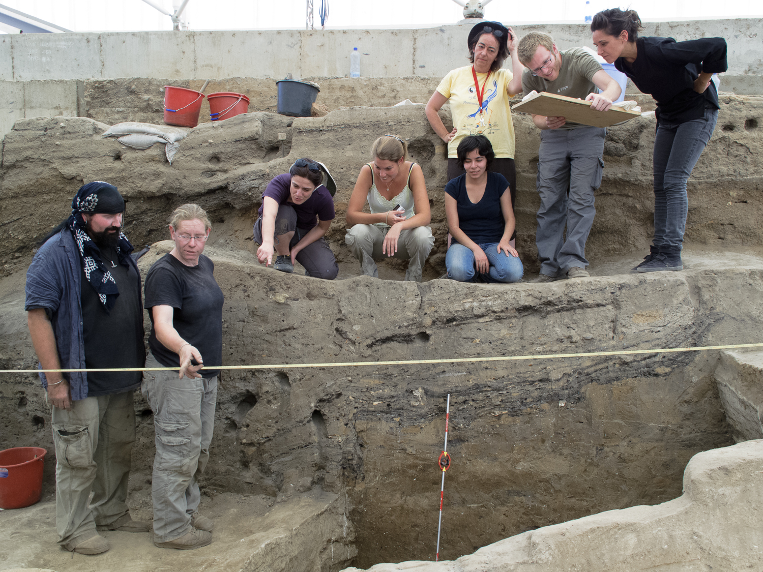
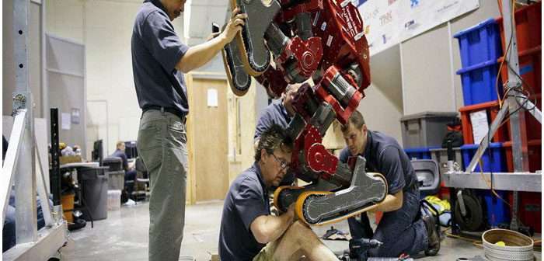
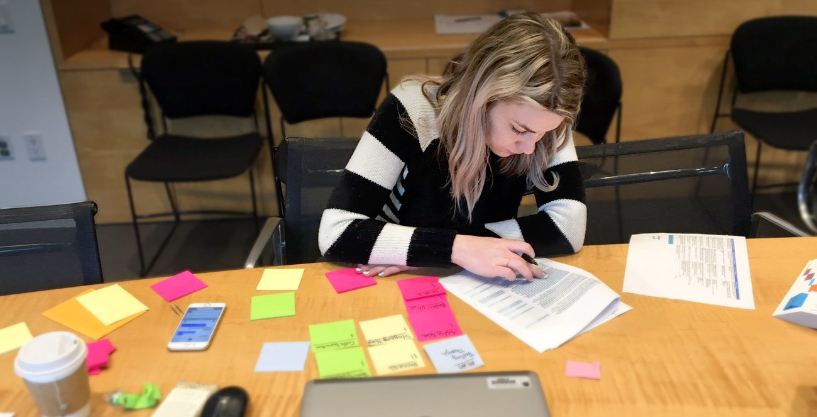
Reflecting on the skills that are used in projects
1. Communication
4. Leadership
KNOW-HOW
When I was a project manager it was my responsibility to oversee and manage the day-to-day operations of the project. This required a range of skills, some of which I already had and some I learned on the job! Dr Alyson Nicholds
PM’s are constantly communicating with key stakeholders to check progress and keep people informed. I had to decide how I’d keep in touch (email/text/ meetings?) and how I’d record it all!
PM’sneed soft skills to keep a project moving forward requires coaching, guiding, motivating, to foster a positive work environment and ensure team are trained and up-to-speed
2. Negotiation
5. Technical expertise
PM’s job to deal with conflict that arose from managing resources, stakeholders. I tried to pre-empting problems by persuading, brokering and compromise to unify goals
PM’s need technical know-how to move projects to completion, they need to ‘speak the language of the subject-matter experts (respect) may involve using project management software to plan, organise and communicate
REFLECTIVE
Which skills have you acquired from your PGT/PGR studies so far?
3. Scheduling
6. Risk Management
PM’s need to be adept at juggling schedules, anticipating roadblocks and changing priorities, requirements, create a well-defined project plan to capture requirements and scope
PM’s need to keep abreast of potential threats on the horizon and plan with mitigation in mind (ethics/ overspend)
What Is Project Management? Definitions, Examples & More – Forbes Advisor
©Leadership Learning All Rights Reserved
Notes:
Key to feeling confident about project management is knowing when you’ve used the skills before

Slide 12
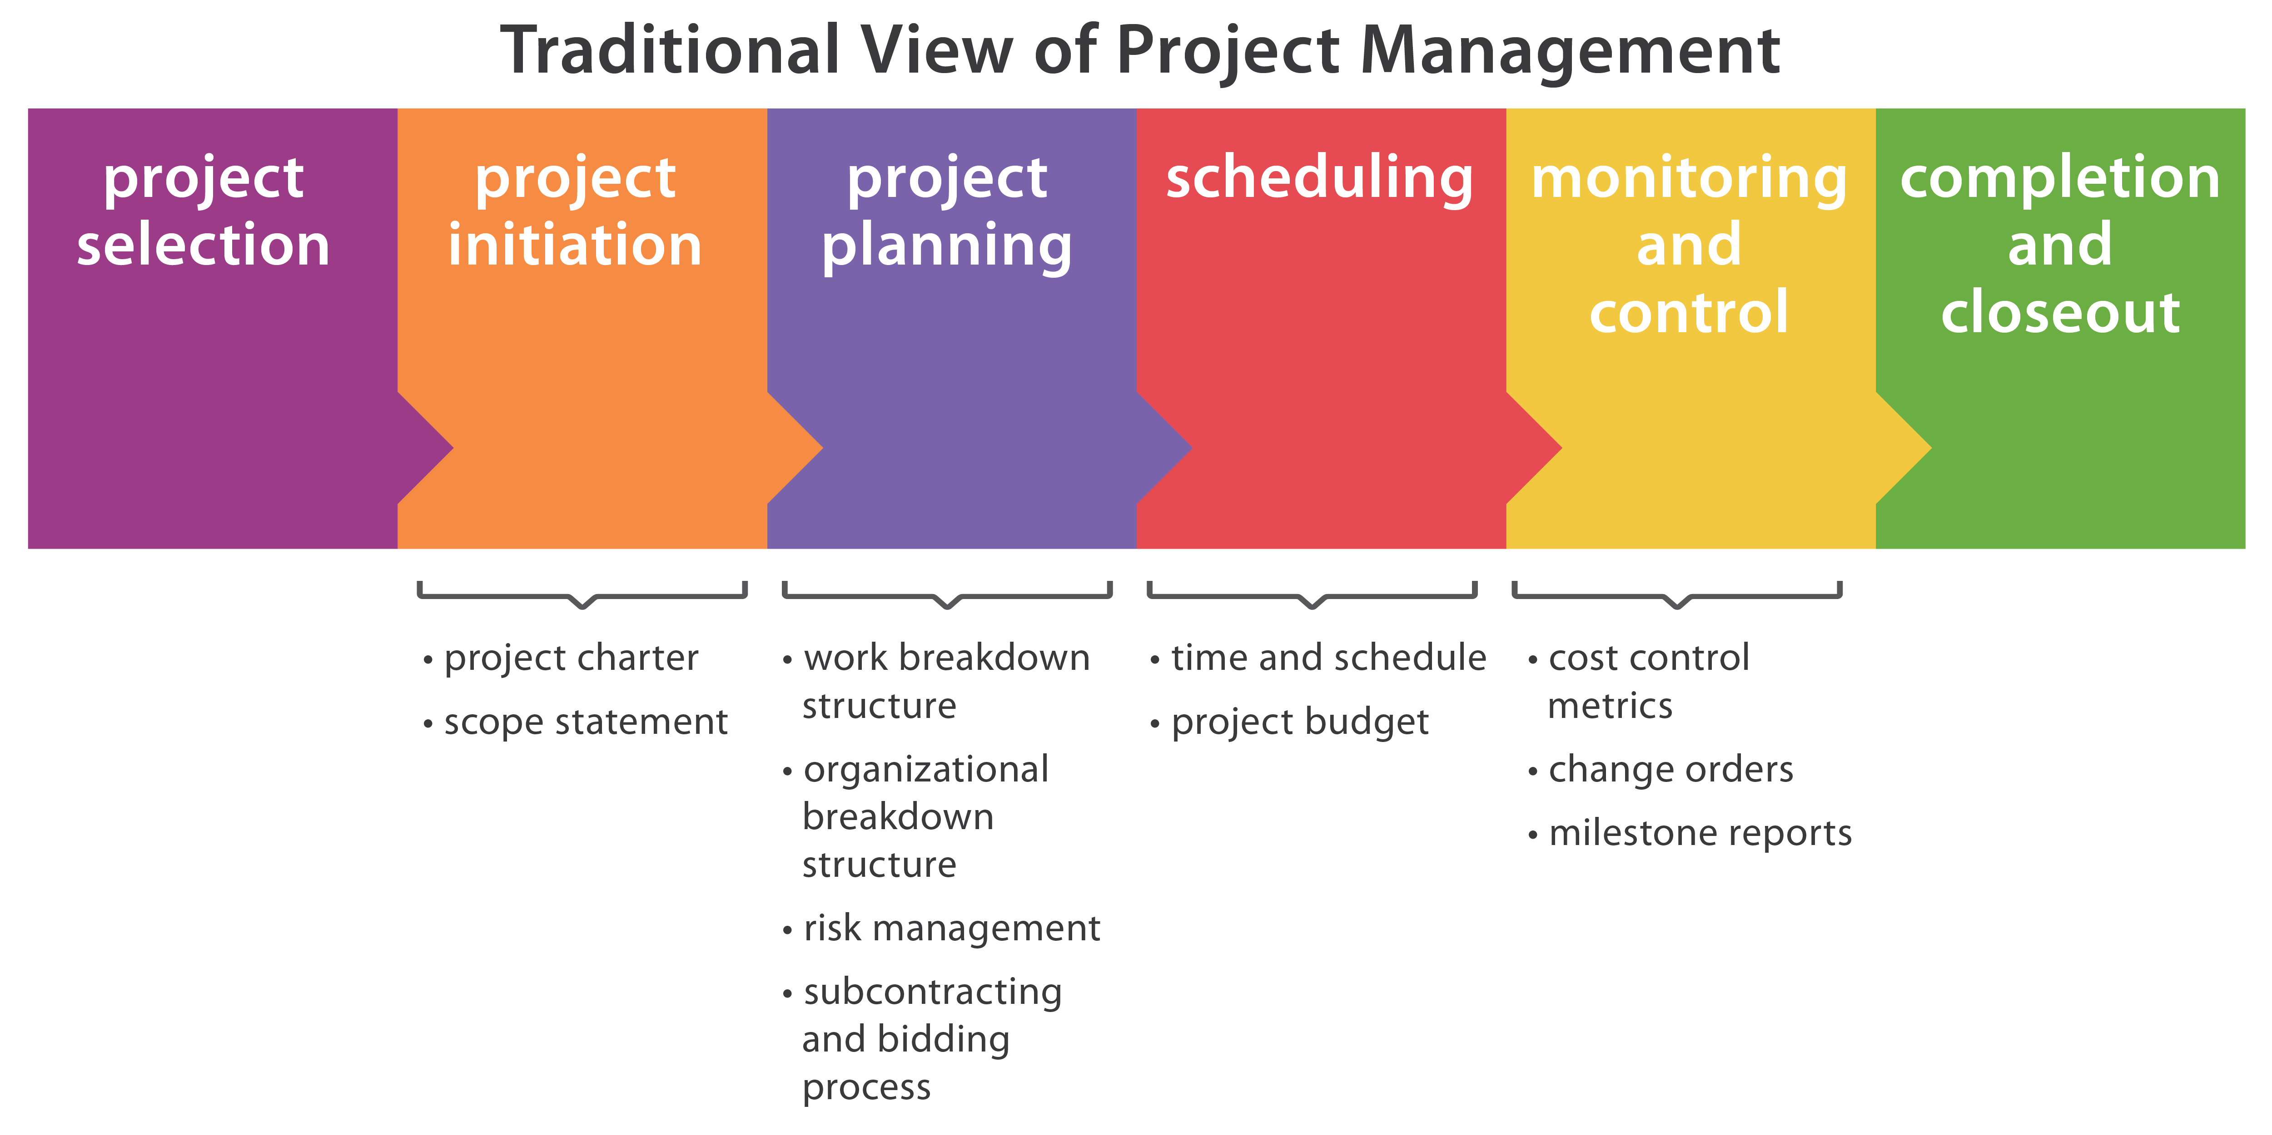
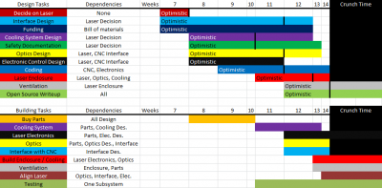
Conceptualising project management
NEEDS
Consider reasons why each issue might be happening (But Why?)
SCOPE
Consider why the project’s needed and where to focus your efforts (i.e. Fishbone)
MAP
Map who is affected by your project (i.e. stakeholder analysis)
PRIORITIES
Ask who is central to meeting the project’s goals (i.e. priority matrix)
ROLES
Decide who is Responsible Accountable Consult Inform (i.e. RACI)
RISKS
Identify, mitigate and control any threats to the projects’ success (i.e. RM)
FINANCIALS
Assess how to fund and sustain the project (i.e. budget)
RESOURCES
Plan how to resource the project (i.e. procurement)
Programme Management
Team kick-off (Who’s in charge?)
Assigning Roles
Programme Director (to manage the day-to-day operations)
Programme Manager (to monitor the process)
What are the needs and requirements? (what do they want?)
Programme Documentation
Sponsor/ Responsible Owner (to liaise with client)
Sponsor (Who’s ultimately responsible?)
Assign roles to everyone in the team
Prepare a Project Initiation Document (PID) (What’s the project?)
Projects Manager (to ensure the deliverables are met on time)
Scope (What are the parameters of the project?)
Stakeholder Reporting & Communications (How will you meet and when?)
Plan with milestones (what will be delivered and by when)
Risk Assessment (can you foresee any problems?)
Financial Assessment (what’s the budget?)
KNOW-HOW
Projects are created by assigning a project lead to take responsibility, then documenting what the project is about (Goals, scope, roles and responsibilities and stakeholders). The it’s just about breaking down the tasks into their constituent parts and turning them into timebound deliverables! Easy!
CONCEPTUALISING
When was the last time you had to structure tasks into activities & deliverables in your PGT/PGR studies?
Important Steps when Building a new Team | MIT Human Resources
©Leadership Learning All Rights Reserved
Notes:
Key to understanding the process of project management is understanding how to plan/organise everything!
This is about knowing about the key stages of the project life cycle, what’s involved in the programme planning and documenting the steps involved (communicate)

Slide 13
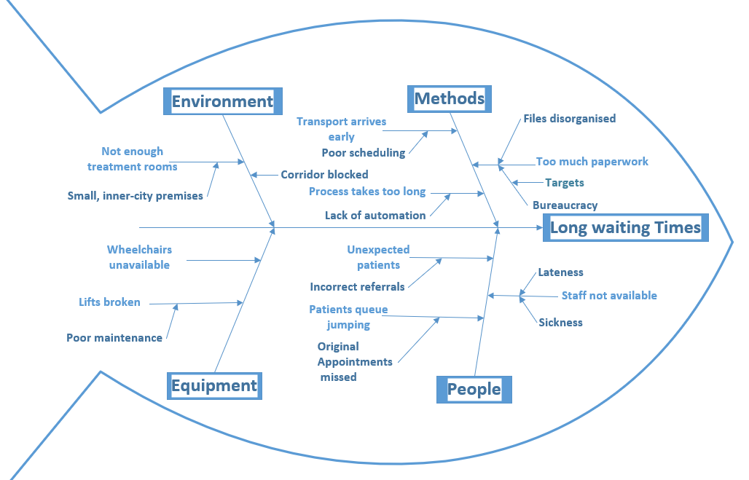
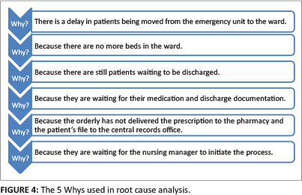
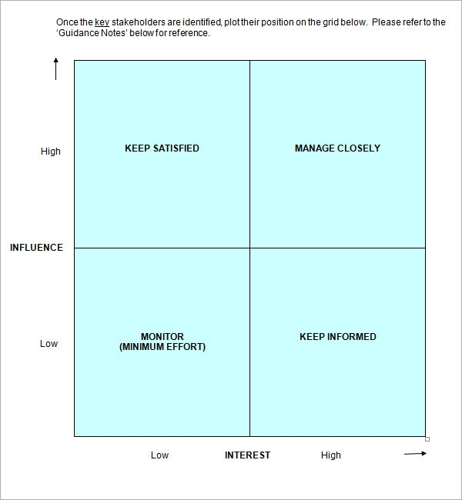
BUILDING YOUR IDENTITY AS A PROJECT MANAGER
Fishbone: What are the issues?
But Why: What’s causing them?
KNOW-HOW
Whenever I work with senior leaders, they tell me that all the theory scares them, but they’ve often done it all before without realising! So, the best way to feel like a project manager to is to identify where you might have used these PM techniques in your studies so far and be able to talk about them as examples of your practice!
SA: Who needs to be involved?
SWOT: Who’s good at doing what?
EXPERIMENTING
Where have you already used these PM techniques in your PGT/PGR studies so far?
Gant: What needs doing by when?
RACI: Who will do what?
What is Project Management | PMI
©Leadership Learning All Rights Reserved
Notes:
Key to building your identity as a project manager is understanding when you’ve actually used the techniques so you can evidence them in interviews/ CV

Slide 14
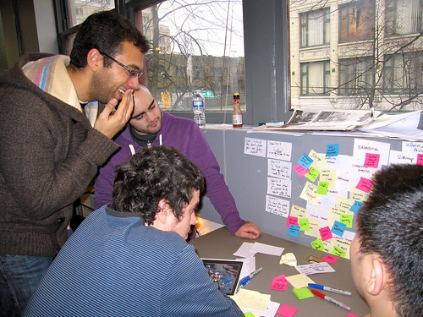
Exercise: Talk about yourself as a real PM!
Job Description
We have amazing opportunity to join our team as a Project Manager in your chosen industry!
Main duties
Facilitate the change project
Communicate with key stakeholders
Coordinate the activities
How would you draw attention to:-
Your past experience of managing projects
Your reflections on the key skills that you have acquired
Your knowledge of PM processes (i.e. planning)
And how you’d go about leading/facilitating (i.e. what PM tools you’d use)
This Photo by Unknown Author is licensed under CC BY
Understanding leadership in the context of transformation projects | APM
Notes:
Abstract: Research literature on the management of projects has been quite slow in its conceptual development and still suffers from a scanty theoretical basis. One of the main impediments in the study of projects has been the absence of constructs and the little distinction that has been made between the project type and its managerial and organizational style. Based on the findings in a field study of 26 case projects, this research shows that there is a need to adopt a more project-specific contingency approach to project management in organizations. This study explores a two-dimensional theoretical model for the classification of technical (or engineering) projects. Projects are classified according to four levels of technological uncertainty at the time of project initiation and three levels of system scope, which is their location on a hierarchical ladder of systems and subsystems. Considerable differences were found in management style, project organization and operational practice when moving along each of the model's two axes. Differences also were observed in simultaneous change in both dimensions. The findings suggest a handful of practical and managerial implications. They are based on the premise that a proper project classification prior to project initiation and a carefully selected management style may lead to better implementation and to an increased chance of project success.
Published in: IEEE Transactions on Engineering Management ( Volume: 45, Issue: 1, February 1998)

Slide 15
Project X: Partnership between Government, Academia and Industry Project X (bettergovprojects.com) (Good for PM research/ evidence-base) Association for Project Management: Professional Body APM | The Chartered Body For The Project Profession (Good for PM Competencies/ Skills) Project Management Institute: Project Management Institute | PMI (Good for PM Processes/ Tools)
Further Information
References
Barret, F., & Hatch, M.J. (2003) Planning on spontaneity: Lessons from jazz for a democratic theory of change. Academy of Management Best Conference Paper
Cunha, D. (?) Developing Project Management Competencies using Role-Playing Games: A case study 043-0683.pdf (pomsmeetings.org)
Cleland, D. I. (1985) A strategy for ongoing project evaluation/ Project Management Journal 16 (3), 11-17.
©Leadership Learning All Rights Reserved

