Slide 1
PG Skills - How to network effectively and build on professional networks
Saira Asif
Daud Amir
Arun Mann

Slide 2
HOUSEKEEPING
Attendance
Timings
Phones on silent
PG Skills Canvas course
PG Skills Canvas Course: https://canvas.bham.ac.uk/enroll/PKYPEA

Slide 3
CAREERS NETWORK IS HERE FOR YOU
1:1 guidance support:
You don’t need to have career ideas or a plan to come and talk to us: we help people who have no idea where to start as well!
To book an appointment, ask a question, have an application checked etc., please email careersenquiries@contacts.bham.ac.uk
PGT-specific opportunities:
Professional Development Award: https://canvas.bham.ac.uk/enroll/H6LJ7T
PGR-specific opportunities:
Career Mentor Beyond Academia: https://canvas.bham.ac.uk/enroll/M7WCDE

Slide 4
Upcoming Opportunities
PG Skills - How to enhance and develop your project management skills
Tuesday 28 November, 12pm – 1:30pm – Save the date!
PPDA - Promoting your Postgrad Skills in CVs and Cover Letters
Thursday 2 November, 10.00 – 11.30
PPDA - Job hunting beyond academia: Top Tips for Postgrads
9th November 15.00 – 16.00 online

Slide 5
ANY QUESTIONS?
Contact us via careersenquiries@contacts.bham.ac.uk
www.intranet.birmingham.ac.uk/careers/pg

Slide 6
PG Skills Session
Making meaningful and impactful connections
Saira Asif
Daud Amir
Arun Mann
Notes:
*IMAGE TIP* Delete placeholder image and click icon to insert preferred image. To change the crop of the image once inserted, click on your picture, then go to the Format Tab > Crop, and adjust as needed.

Slide 7
Introduction to Turner & Townsend
Turner & Townsend is a global professional services company with over 10,000 people in 48 countries. Collaborating with our clients across real estate, infrastructure and natural resources sectors, we specialise in major programmes, programme management, cost and commercial management, net zero and digital solutions.
Programme strategy and set-up - setting up for success – building the right capabilities and execution plan to drive clear programme outcomes.
Programme management - looking at the big picture, driving better overall outcomes, and having real confidence your programme is under control.
Cost and commercial management - driving and safeguarding your commercial interests from start to finish.
Project management - delivering project success through effective planning, the right team and rigorous controls.
Procurement - developing and delivering procurement and supply chain strategies that get the best results from the market.

Slide 8
Safety, health and quality - embedding the strategies and culture that support effective operations and maintain a safe and healthy environment
Controls and performance - applying robust and pro-active controls from a clear baseline to deliver confidence in programme and project performance
Technology and data - unlocking the potential of technology, data and information modelling to drive performance, support great decision-making and create collaborative working environments.
Advisory - providing independent advice to help make your business and investments a success.
Expert opinion - when disputes require expert services, we support legal firms on quantum and delay services.
Productivity improvement - identifying inefficiencies and opportunities to improve every stage of projects, programmes and operations.
Our current job role
Our individual career Journey
How networking has helped us in our career (one fact)

Slide 9
Objectives
The session aims to equip you with a clear understanding of the different types of networking; the power of networking and the benefits of networking. The session will aim to focus on several areas to consider when building on professional networks, such as, finding a mentor, using LinkedIn, and how to make the most of recruitment events.
Three objectives for this session:
1
Understand the foundations of networking and how networking can help you.
2
3
Understand the nature of recruitment processes and how to work smartly to target and network with specific employers.
Be aware of the importance of your LinkedIn profile, and how to build on your professional brand.

Slide 10
Agenda
Ice breaker
Networking
Mentoring
CV writing
LinkedIn
Recruitment Process and GDP Overview
Case study
Q&A – All

Slide 11
Ice Breaker - NSEW
Imagine the room is a world map. We want you to walk around the room and discuss with others where you think in the world the following things are. Take this opportunity to get to know each other and travel the world!
Where in the world:
Oldest tree
Most grapes exported
Oldest University
Lowest birth rate
Most expensive building

Slide 12
Networking
What is networking?
Networking is all about the practise of establishing and maintaining connections with individuals or groups for various reasons e.g. professional or social interactions.
Professional networking is focused on establishing connections with individuals or groups within your industry or field to exchange information, advice, and opportunities. It’s often used for career advancement, job hunting or business growth.
Types of networking
Professional networking
Social Networking Sites
Conferences
Seminars and Workshops
Forums and discussion boards

Slide 13
Why is networking important
Why is networking important in business
Opportunity discovery
Knowledge sharing
Career Advancement
Support and guidance
Business Growth
Improved communication skills
Diverse perspectives
Staying informed
Problem solving

Slide 14
How to Network as a PG student
How to network and what is effective networking
Identify your goals and what you want to accomplish e.g. a better job/role, career change, advice
Leverage alumni networks at UOB, share your Masters/Research project, find individuals with a similar academic route
Attend industry events in work you are passionate about e.g. IOM3 events
Seek informational interviews (ask professionals in the industry you are interested in)
Skills you already have that can be conducive to successful networking
Specialised knowledge
Research skills
Critical thinking
Adaptability
Project management
Problem solving
Continuous learning

Slide 15
Networking: Hints and Tips
Introduce yourself
Set clear goals
Active listening
Body language
Ask open-ended questions to learn about the person
Create a connection
Gratitude
Maintain relationships: suggest a future meeting and follow up
Attend Networking Events (career fairs)
Online networking (bright network, linkedin)

Slide 16
Networking: Do’s and Don’ts
Do set clear goals
Do be authentic
Do listen actively
Do ask open ended questions
Do follow up
Do diversify your network
Do attend networking events
Do utilise online networking
Do offer value
Don’t monopolise conversations
Don’t limit your network
Don’t overshare personal information
Don’t criticize or complain/ be disinterested
Don’t be impatient
Don’t violate boundaries : don’t ask personal questions
Don’t be negative about previous employers or experiences

Slide 17
Mentoring Opportunities
Professional organisations offer mentoring programs
Mentoring programs that pair students with alumni/ experienced professionals
LinkedIn’s: Mentor match (Mentoring.org)
Shadow a professional worker
Bright Network
EQUAL PATHWAYS: SUCCESS STORY
Connecting engineering professionals with mentors and providing opportunities for career development and guidance
Visit official website, check application period, complete application, submit required documents

Slide 18
Post Graduate CV Tips
Well Structured Summary/Career Aims & Interest
Highlighting relevant academic modules
Demonstrate IT, Technical, & additional skills

Slide 19
Summary & Skills

Slide 20
Education Section

Slide 21
Make your Experience Standout
Use of Actions/Dynamic verbs in writing your experiences
Mention the benefit your employer/client got from your work
Use of statistics/facts/figures to develop a stronger argument
Highlight the new skills developed/learnt as part of the role

Slide 22
Examples

Slide 23
Case Study – International PG Student
Journey to date highlighting key milestones
Challenges faced by international PG students in Networking/job hunting
Key skills to focus on to overcome barriers

Slide 24
Why Optimise your LinkedIn
A profile with a profile photo can result in 14x more views by recruiters and hiring managers than one without a photo.
A 1st person conversational summary of at least 40 words and up to 2000 characters ranks high in Recruiter searches
Adding an industry to your profile can land you 15x more profile views
Members that include skills in their profile (up to 50) are 13x more likely to get profile views.
Members who include an Education section on their profile are 10x more likely to be found in a recruiter search.
42% of hiring managers surveyed by LinkedIn said they view volunteer experience as equivalent to traditional work experience
Join groups in your target industry and engage in likes, comments, and conversation. Your profile is 5x more likely to turn up in a search result then.

Slide 25
Skills Development during PG Studies
Active listening
Communication
Confidence
Public Speaking
Humour
Interpersonal Skills
Emotional Intelligence
Respect

Slide 26
Network Building Opportunity as a PG
Discussions around taught modules – specific topics within modules
Approaching people to get visibility before finalising your research topic
Networking with various subject matter experts to acquire candidates, as part of your research methodology
Reaching out to recruiters, who are hiring for your target roles (roles that require similar knowledge/skills)

Slide 27
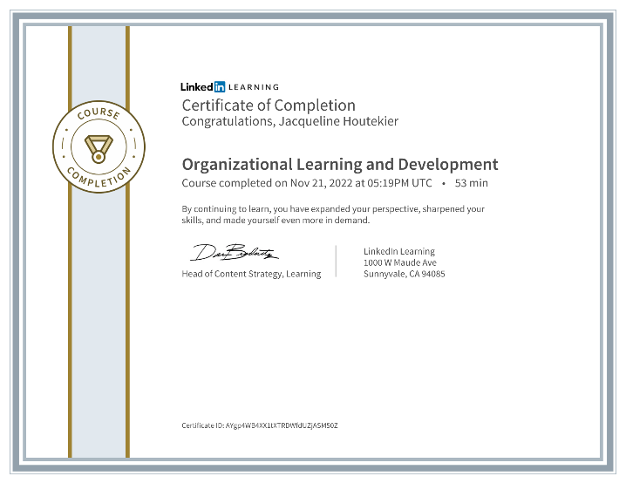
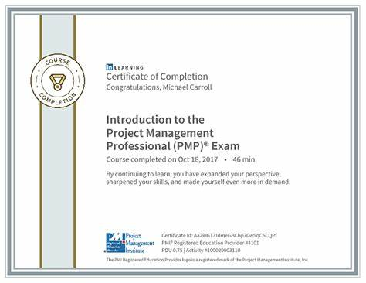
LinkedIn Certificates
Certificates:
General LinkedIn Learning certificates are all delivered by professionals whom you can interact with if you want to widen your network or even ask questions about the topic you chose.
Accredited Certificates:
Some certificates are accredited by organisations and can boost your reputation. This can be considered as a professional qualification.

Slide 28
Graduate Development Programme (GDP) Recruitment Process: T&T example
Online Application Form: If successful you will then be invited to complete our online assessment
Online Assessment: A timed online assessment and to be completed in a week.
Video Interview: This will focus on competency questions as well as motivation.
Assessment Centre: It will take place between January and April.
Offer and onboarding: You will hear your outcome approx. 10 working days after your assessment center. You will find our which team, location and programme you have been offered.
2024 Graduate Programme Applications are open now

Slide 29
Graduate Development Programme (GDP)
What is the GDP?
A structure learning environment providing graduates with skills and experience you need to be successful
Blended with external qualifications, such as:
Royal Institution of Chartered Surveyors (RICS)
Association For Project Management (APM)
Chartered Institution of Building (CIOB)
Institution of Civil Engineers (ICE)
3) May need to visit and work from client sites, so be mobile and as flexible as possible!

Slide 30
Q&A Panel
We will take verbal questions first but feel free to use our anonymous Q&A solution

