Slide 1
How to enhance and develop your project management skills
Gina Smith
Senior Project Manager
Dr Holly Prescott
PGR Careers Adviser
Notes:
*IMAGE TIP* Delete placeholder image and click icon to insert preferred image. To change the crop of the image once inserted, click on your picture, then go to the Format Tab > Crop, and adjust as needed.

Slide 2
Housekeeping
Timings
Questions
PG Skills Canvas course https://bham.targetconnect.net/leap/event.html?id=18000&service=Careers+Service

Slide 3
Careers Network is here for you!
1:1 guidance support:
You don’t need to have career ideas or a plan to come and talk to us: we help people who have no idea where to start as well!
To book an appointment, ask a question, have an application checked etc., please email careersenquiries@contacts.bham.ac.uk
PGT-specific opportunities:
Professional Development Award: https://canvas.bham.ac.uk/enroll/H6LJ7T
PGR-specific opportunities:
PGR Careers Beyond Academia Canvas course: https://canvas.bham.ac.uk/enroll/LXBH7H
PGR Careers in Academia Canvas course: https://canvas.bham.ac.uk/enroll/TCMRHD
Next session: PG Skills - Generating Ideas for Creative Problem Solving
Tuesday 5th December 2023, 2:00pm - 3:30pm
Session delivered by Nicola Gittins, Deputy Director of Student Entrepreneurship and Enterprise. https://bham.targetconnect.net/leap/event.html?id=18000&service=Careers+Service

Slide 4
Session Outline
Session Objectives
Speaker Intro
What is Project Management?
Key Principles of Project Management
Career application
Project Management in Practice
Activity
Resources

Slide 5
Session Objectives
Describe what project management is and the skills it requires
Recognise how project management skills are beneficial in the workplace
Use examples from your postgraduate studies/ research to demonstrate project management skills
Improve you project management skills to benefit your chosen career path

Slide 6
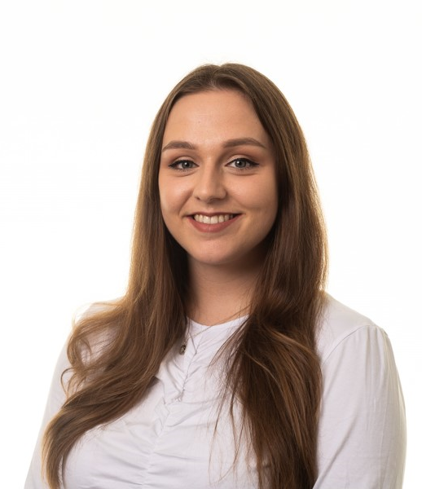
Introduction to Speaker
Gina Smith
Senior Project Manager
BSc Building Surveying and the Environment – Sandwich Degree, University of Plymouth
6 years of experience
Clients: Severn Trent Water, High Speed 2, West Midlands Combined Authority, Birmingham Airport
Other Roles Held: Line Manager, Graduate Development Manager, Rail Sector Lead (Midlands), Volunteering Lead, University Engagement Lead

Slide 7
Ice breaker: what is a project?
A piece of work: that has a final deliverable and a finite timespan, rather than something which is just an ongoing process. Give us an example from your academic work or work experience so far?
Notes:
- Piece of research written up as thesis/ dissertation
- Essay
- Group project/ presentation
- An event - A conference paper…

Slide 8
What is project management?
“Project management is the application of processes, methods, skills, knowledge and experience to achieve specific project objectives according to the project acceptance criteria within agreed parameters. Project management has final deliverables that are constrained to a finite timescale and budget.” APM Body of Knowledge, 7th Edition
Notes:
*TABLE TIP* The sample quotation has been set up as a table cell. Type in your quotation and resize the table cell height as required, by dragging the bottom border up/down.

Slide 9
Project Management Principles
Define the reason why a project is necessary.
Assemble project team, capture project requirements, specification, resources and timescales
Prepare a Business Case to justify the investment
Secure corporate agreement and funding aka ‘approval’
Set the scene; lead and motivate the project delivery team
Develop and implement the Project Management Plan
Identify and manage risks, issues, changes and opportunities
Monitor progress against the plan and manage project budget
Maintain communication with stakeholders and project organisation
Project handover and closure
Notes:
12:20

Slide 10
Applying project management principles to your academic work: match-up exercise
PM terminology | Academic activity
Business case | Agreeing regular meetings with supervisor
Project plan | Following ethical procedures to keep participant data confidential so that this is not breached
Risk management | Reaching a compromise when supervisors disagree on how question should be approached
Progress monitoring | Successfully identified a novel link between COVID conspiracy theories and internet browsing behaviour to help combat misinformation
Stakeholder management | Formulating a research proposal
Delivery and closure | Chapter outline(s)

Slide 11
Applying project management principles to your academic work: match-up exercise
PM terminology | Academic activity
Business case | Formulating a research proposal (setting research objective/ question)
Project plan | Chapter outline(s) and schedule
Risk management | Following ethical procedures to keep participant data confidential so that this is not breached
Progress monitoring | Agreeing regular meetings with supervisor
Stakeholder management | Reaching a compromise when supervisors disagree on how question should be approached
Delivery and closure | Successfully identified a novel link between COVID conspiracy theories and internet browsing behaviour to help combat misinformation

Slide 12
Career Application - Skills
Flexibility
Time management
collaborator
Proactive and motivated
Logical thinker & problem solver
Leadership
Leadership
Strong Microsoft Skills
Organised
Able to identify priorities
Independent
Communication skills; verbal and written
Good listener
Good listener

Slide 13
Career Application - Synergies
Project Management is an important skill to recognise and develop as albeit you may not be focussed on it as a career path, the likelihood is your chosen role or industry will require some degree of project management skill.
Office Manager: often a leader, someone who needs to motivate and drive a team of people forward to achieve targets and goals.
Teacher/lecturer: devises lesson plans to fulfil an educational brief, responsible for the wellbeing of people and ensuring everyone tries to achieve their best.
Researcher: is responsible for research for a specific topic and presenting on findings to drive further research, products and decisions. Will deliver research as part of a brief against time, quality and cost parameters.
Engineer: responsible for design and developing technical solutions as per specifications, standards and brief. Needs to deliver against timescales and budget.
Notes:
12:40

Slide 14
Project Management in Practice
Heathrow Terminal 5
What skills and processes do we need to make this project (or in this case programme) successful?

Slide 15
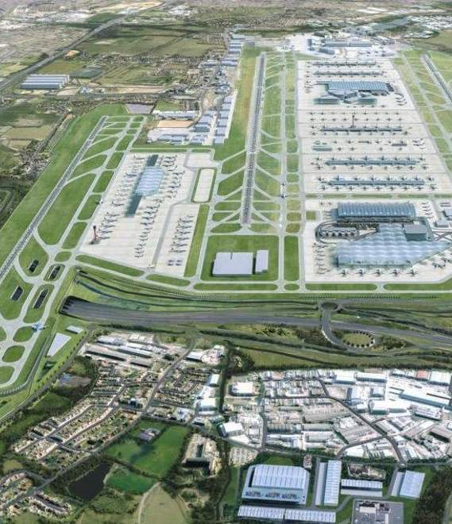
Project Management in Practice
Comprehensive plans and tools
Clear lines of accountabilities and responsibilities
Breaking down the work into packages, also known as work breakdown structure
Clear definition and review schedule of project deliverables and goals
Established reporting structure
Transparent and honest communication
Dedicated functions e.g. procurement, health and safety, commercial teams
Transparent and robust stakeholder management
Interface consideration and management
New runway and facilities
New airstands and apron
New terminal building
New public transport and surface mobility
Community compensation scheme
Notes:
12:50 Question: what skills and processes are needed to make this project/programme successful?

Slide 16
Demonstrating Project Management Skills: Activity
Project management in interview questions:
Talk me through a project that you’ve worked on and how you kept the project on track
What project management tools and methodologies do you use?
How do you respond when something doesn’t go to plan on a project you are working on?
How do you prioritise when working across multiple projects?
Talk me through a project that you’ve worked on and how you kept the project on track?
What was the project?
What needed to be achieved?
How did you follow principles we’ve discussed today:
Making a business case
Progress monitoring
Risk management
Stakeholder management
What was the result?
Notes:
Up until 13:00

Slide 17
Caveats
Postgrads DO have a well-rounded skillset that is applicable to working in a project management role:
Written and verbal communication skills
Ability to manage your time
Juggling multiple ‘projects’ (e.g., thesis, teaching, conferences, etc.)
Getting to grips with new topics
Managing large amounts of information
BUT…
PG study alone often doesn’t give you experience of using all those skills with the pace or frequency that a professional project manager does.
SO…

Slide 18
To improve your project management skills…
Get used to using project management language by applying the principles of project management to your thesis/ dissertation early on
Use project management software in your research, e.g. Trello; building a programme in Excel to map out your project plan/ chapter plan
Get some experience of applying your skills to a project beyond your usual academic setting:
Masters Consultancy Challenge
Postgraduate Enterprise Summer School
Organising a conference
Managing a campaign with a Guild society

Slide 19
Resources
Association for Project Management Podcasts and CPD
Association for Project Management ‘Project Journal’ articles
Association for Project Management (and alike) online and in person knowledge shares
Linkedin courses and articles
Courses such as Prince2, grow with google project management certification, APM PFQ, PMQ
Grow your network on LinkedIn!
https://www.apm.org.uk/resources/the-apm-podcast/
https://www.apm.org.uk/resources/member-resources/project-journal-all-issues/
https://www.apm.org.uk/events/#full
https://www.linkedin.com/learning/paths/become-a-project-manager

Slide 20
Summary
You should now:
Have an understanding of what project management is and the skills it requires
Be able to articulate why project management skills are beneficial for a multitude of career paths
Apply project management principles to your post graduate studies and research to demonstrate what project management skills you already have
Understand how to grow your project management skills to take forward into your chosen career path

Slide 21
Turner & Townsend
Low Hall
Calverley Lane
Horsforth
Leeds
LS18 4GH
t: 07813532636
e: gina.smith@turntown.co.uk
www.turnerandtownsend.com

