Slide 1
Do you remember learning to tie your shoes? We guess you didn’t learn by watching a video or listening to a lecture…. You learned by being shown and by practicing. The same applies to our teaching!

Slide 2
Modelling as an instructional strategy in geography
By Suzanne and Laura
Notes:
S

Slide 3
Task
What does the term classroom modelling mean to you?
Notes:
S- Introduce task
L- Get feedback
2 mins task
3 mins feedback

Slide 4
Seminar Objectives
To understand the concept of modelling
To recognise the different styles of modelling
To learn how to model tasks in the Geography classroom
Notes:
S

Slide 5
Seminar Structure
What is modelling?
The theory of modelling
Different types of modelling with classroom examples
The advantages and disadvantages of modelling
What the future may hold for classroom modelling
Summary
Notes:
L

Slide 6
What is modelling?
Eggen and Kauchak (2001)
Modelling is an instructional strategy in which the teacher demonstrates a new concept or approach to learning and students learn by observing.
Haston (2007)
Whenever a teacher demonstrates a concept for a student, that teacher is modelling.
Notes:
S

Slide 7
Biggs and Moore (1993)
Teachers need to realise that there is no one way in which students go about learning; that some ways are more effective than others; and that, most importantly, there are things we as teachers can do to optimise the chances that students will go about learning in the most desirable ways.
Notes:
L

Slide 8
Think, Pair, Share
Write down one way that you have….
Experienced modelling during your own education;
Modelled a task for your students when teaching.
Share these experiences with the people on your table.
Notes:
S- Introduce
L- Feednack
3 mins chat
2 mins d

Slide 9
The theory of modelling
Research suggests that modelling is an effective instructional strategy in allowing students to observe the teacher’s thought processes.
Bandura (1977)
Learning would be exceedingly laborious, not to mention hazardous, if people had to rely solely on the effects of their own actions to inform them what to do.
Bandura (1986)
Modelling engages students and encourages learning.
Notes:
S

Slide 10
Most human behaviour is learned observationally through modelling.
Research has shown that modelling can be used across disciplines and in all year and ability level classroom.
A model can provide examples of what is expected of the students in terms of work and/or behaviour.
A teacher can model by using visual, auditory, tactile, and/or kinaesthetic instructional techniques.
Notes:
L

Slide 11
Types of modelling
Disposition
Task and performance
Metacognitive
Scaffolding technique
Student-centred
Notes:
S

Slide 12
Disposition modelling
Teachers convey personal values or ways of thinking.
Teachers can model desired personal characteristics.
Eurich (1995)
Important for facilitating the development of character and community.
Duplass (2006)
Model strategies needed to succeed.
Notes:
S

Slide 13
Classroom example
Student Task: Design an eco home for the future.
Tell the students what features their house could include and draw an exempla diagram.
Notes:
L- This type of modelling is about characteristics and values and the teacher making the student into a good citizenship

Slide 14
Task and performance modelling
Teacher demonstrates a task which students will be expected to do on their own.
Used so students can first observe what is expected of them.
Notes:
S

Slide 15
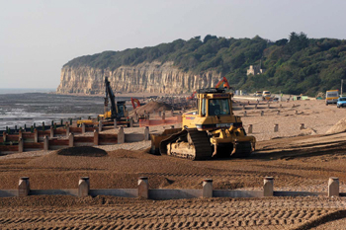
Classroom example
Teacher models a different coastline to the students case study
Notes:
L- Students are expected to do an assignment on an particular coastline- describe the coastal defences and why the coastline needs to be protected using specific examples and stats- teacher can model a different coastline

Slide 16
Metacognitive modelling
Thinking skills that focus on interpreting information and data, analysing statements and making conclusions about what has been learned.
Teachers talk through their thought process whilst doing the question.
Duplass (2006)
This is a thinking-out-loud approach.
Notes:
S

Slide 17
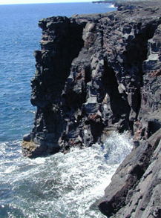
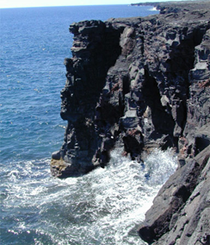
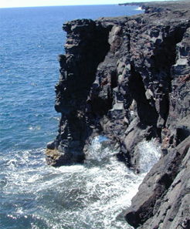
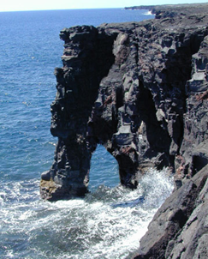
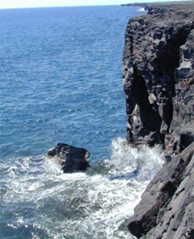
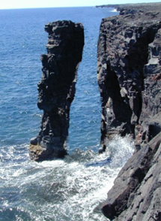
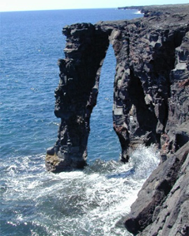
Classroom example
The erosional processes resulting in the formation of a stump:
Notes:
L

Slide 18
Modelling as a scaffolding technique
Teachers model the task, and then students work through the task at their own pace.
EXEL (1996)
The model is only a draft which students can amend and add to.
Baldwin et al (2006)
Teachers can model the task multiple times for students who have learning disabilities or English as an additional language.
Notes:
S

Slide 19
Lambert and Balderstone (2010)
Teacher modelling/demonstration
Joint activity
Scaffolding activity
Independent activity
Notes:
L

Slide 20
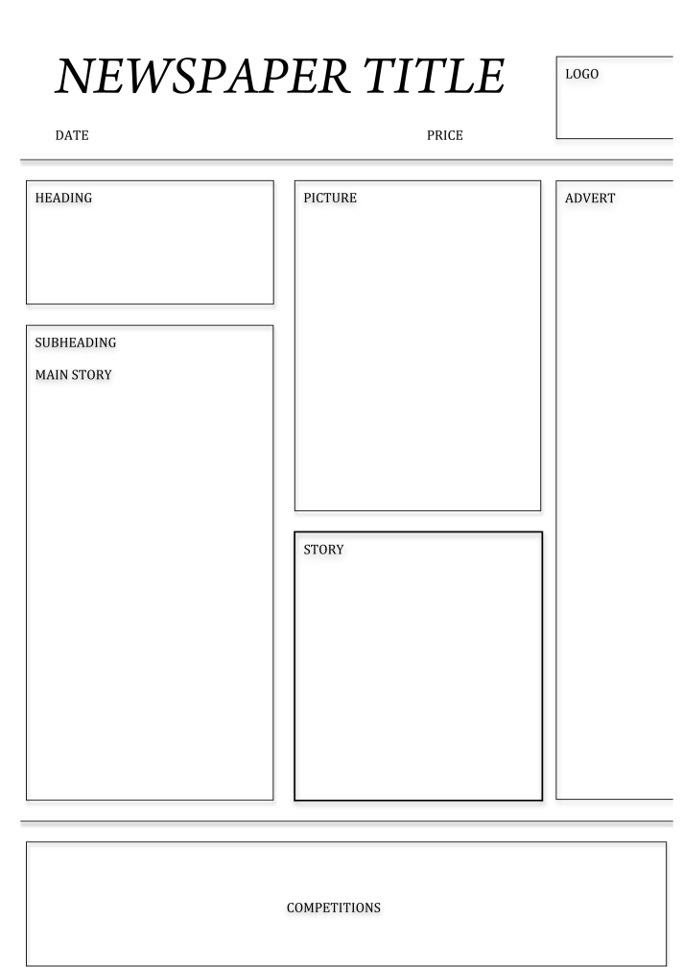
Classroom example
Extended piece of writing: Newspaper article
Layout: headline, subheading, picture, picture Caption, writing in columns
Language: Who is your audience?
Notes:
L- Teacher models whole task and students go through at own pace- Newspaper article- headline, subheading, picture, picture caption, language, writing in colums

Slide 21
Student-centred modelling
Teachers can often call on students to model expected behaviours or thought processes.
Haston (2007)
Teachers engage students who have mastered specific concepts or learning outcomes and model the task for their peers.
Duplass (2006)
Less teacher led
Notes:
S

Slide 22
Classroom example
Group work setting
Carousel activity
Lead learners are those who are modelling
Notes:
L- Lead learners can be G&T students to incorporate challenge into your lesson

Slide 23
Review: Think, Pair, Share
Write down as many advantages and disadvantages of modelling you can.
Then in pairs or with the people on your table discuss your answers.
Advantages | Disadvantages
Notes:
S- Introduce
L- Feedback

Slide 24
Advantages of modelling
Modelling can often make the unclear clearer.
Some activities cannot be adequately expressed in words.
Using this type of instruction, teachers engage students in imitation of particular behaviours that encourage learning.
Modelling can promote inclusion.
Modelling can help teachers measure the difficulty or work load of their students.
Metacognitive modelling is particularly useful for exam groups.
Stops students wasting time because they “can’t think of anything.”
Notes:
L- read through only the ones people didn’t give in feedback

Slide 25
Disadvantages of modelling
Possibility to offend students if teachers are not working with empathy and integrity.
Students may begin to “expect” models.
Less able students are more likely to accept what is being modelled and not challenge it.
Reduces students own thinking and creativity skills.
Agnes (2000)
Students are replicating teachers models in tasks which require imagination.
Haston (2007)
When used inappropriately it can inhibit learning.
Notes:
L- only read through the ones others didn’t get in feedback

Slide 26
Review Task
In groups, using your student profile and a topic of your choice, decide how you would go about modelling a task to meet the needs of that student.
Notes:
S- Introduce
L- Feedback

Slide 27
Seminar Summary
There is no right way to model!
The type of modelling used is dependent on the audience you have in front of you.
Do your advantages out way the disadvantages in your classroom?
Most human behaviour is learnt through modelling and practice.
When a teacher demonstrates a new concept, they are modelling.
Many of us would of experienced modelling at school and taught through the use of modelling without recognising it as modelling!
Notes:
L

Slide 28
References
*Agnes, M. (2000) Webster’s New World College Dictionary. Foster City CA: IDG Book Worldwide Inc.*
*Baldwin, M., Keating, J. and Bachman, K. (2006) Teaching in Secondary Schools: Meeting the Challenges of Today’s Adolescents. Upper Saddle River NJ: Pearson.
Barnes, D. and Todd, F (1977) Communication and learning in small groups. London: Routledge.*
Bartlett, S. Leask, M. (2005) Improving your teaching an introduction to practitioner research and reflective practice. Unit 5.4 in Capel, S and Leask, M. and Turner, T. eds Learning to teach in the secondary school, a companion to school experience. London: Routledge.
*Bandura, A. (1986) Social Foundations of Thought and Action: A Social Cognitive. Englewood Cliffs NJ: Prentice Hall.*
*Bandura, A. (1977) Social Learning Theory. New York: General Learning Press.*
Bates, B. and Walton, M. (1993) Guidelines for secondary schools for effective differentiation in the classroom. Essex: Essex County Council Education Department.
Batesby, J. (1995) Teaching geography at KS3. Cambridge: Chris Kington Publishing.
Bennett, N. (1995) Managing learning through groupwork. In Desforges, C. eds. An introduction to teaching psychological perspectives. Oxford: Blackwell.
Biggs, J. and Moore, P. (1993) The Process of Learning. Sydney: Prentice Hall.
Capel, S. Keask, M. and Turner, T. (2005) Learning to Teach in the Secondary School, a Companion to School Experience. New York: Routledge.
Davidson, G. (2006) Start at the beginning in teaching geography. 31 (3) 105-108.
DfEE (2000) Research into teacher effectiveness: a model of teacher effectiveness. London: Hay McBer/DfEE.
DfES (2002) Literacy in geography. London: DfES.
*Duplass, J. (2006) Middle and High School Teaching: Methods, Standards, and Best Practices. Boston: Houghton Mifflin Company.*
*Eggen, P. and Kauchak, D. (2001) Educational Psychology: Classroom Connections. 5th ed. New York: Macmillan.*
*Eurich, G. (1995) Theory into practice: Modelling respect in the classroom. Intervention in School and Clinic. 31 (2): 119-121.*
EXEL (1996) Writing Frames. Exeter: University of Exeter School of Education.
George, J., Clarke, J., Davis, P. and Durbin, C. (2002) Helping students to get better at geographical writing in teaching geography. 27 (4) 156-160.
Ghaye, A. and Robinson, E. (1989) Concept maps and childrens thinking; a constructivist approach in Slater, F. ed language and learning in the teaching of geography. London:Routlegde.
*Haston, W. (2007) Teacher Modelling as an Effective Teaching Strategy. Music Educators Journal. 93 (4): 26.*
Jacobson, D., Eggen, P. and Kauchak, D. (1981) Methods for teaching a skills approach. Columbus OH: Merrill Publishing.
Joyce, B. and Weil, M. (1980) Models of teaching. New Jersey: Prentice Hall.
Lambert, D. and Balderstone, D. (2010) Learning to Teach Geography in the Secondary School, a Companion to School Experience. (2nd ed) New York: Routledge.
McCormick, J. and Leask, M. Teaching styles in Capel, S., Leask, M. and Turner, T. (2005) Learning to teach in the secondary school, a companion to school experience. London: Routledge.
Novak, J. and Gowin, D. (1984) Learning how to Learn. Cambridge: Cambridge University Press.

Slide 29
What does the future hold for modelling?
What do you think the future holds for modelling?
Should modelling be incorporated more into teacher training?
Do you think modelling has a place within all geography lessons?
Notes:
S

Slide 30
Any questions?

